Slide 1
How to access CCAF Degree
Requirements in AU SIS

Slide 2
Step 1
Go to: Home (af.mil)
https://aueems.cce.af.mil/sap/bc/ui2/flp#Shell-home

Slide 3
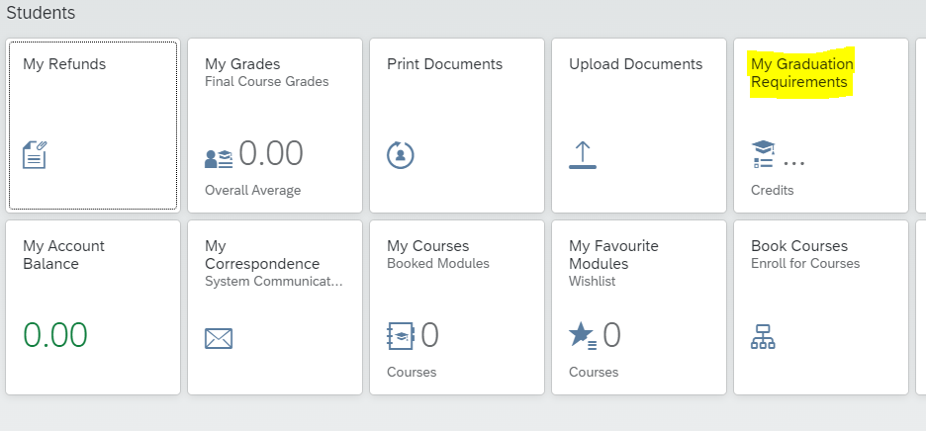
Step 2
Click “My Graduation Requirements”

Slide 4
Step 3
Click the drop down arrow to select which degree

Slide 5
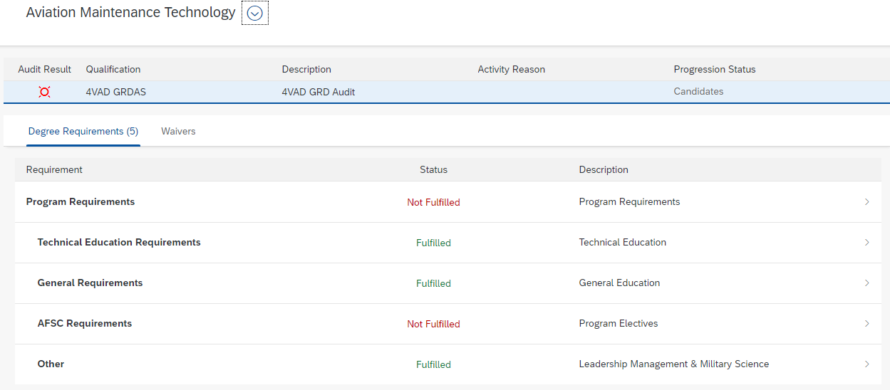
Step 4
Wait until you get this view.
It is slow and may take a few minutes. If the “Status” isn’t green or red then you need to continue to wait! It also won’t show you that its loading or doing anything so be patient!

Slide 6
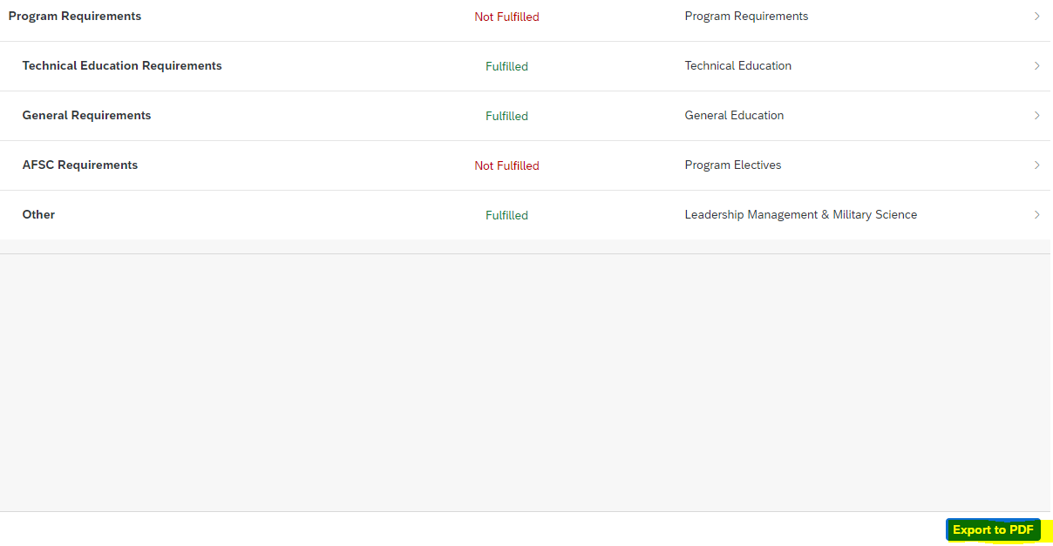
Step 5
Click Export to PDF in the bottom right of the screen

Slide 7
Step 6
Review Degree Audit
-Areas in green are what is completed
-Areas in red are needed
-AFSC check is done right before nomination to gradation

Slide 8
CCAF TRANSCRIPT STATUS

Slide 9
Keep in mind
CCAF is 1000’s of transcripts behind and action requests(Tickets) behind
If you don’t see your courses or credits from outside colleges and you sent your transcripts in before July 2023 then CCAF never got it, and they will have to be resent.
Parchment is the preferred method of CCAF to get transcripts.

