Slide 1
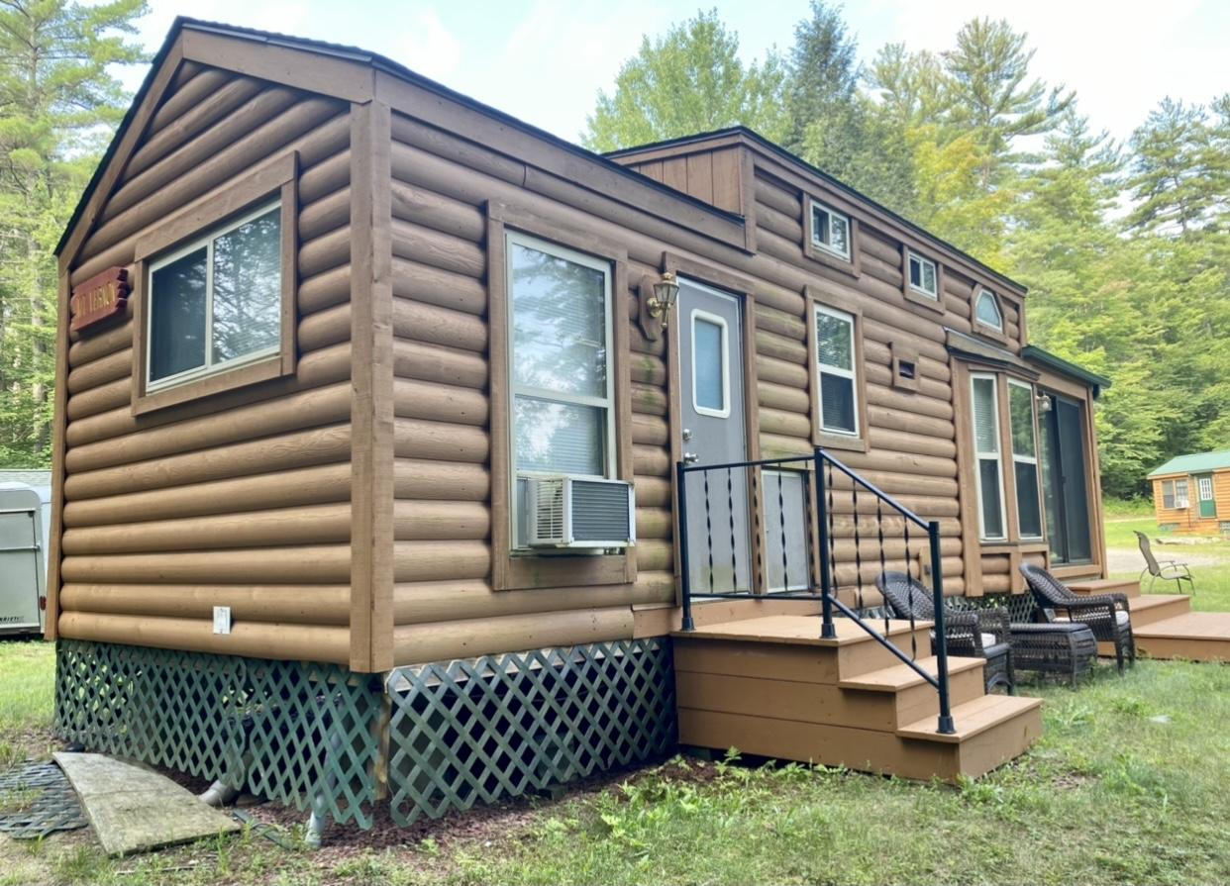
AMHERST CABIN

Slide 2
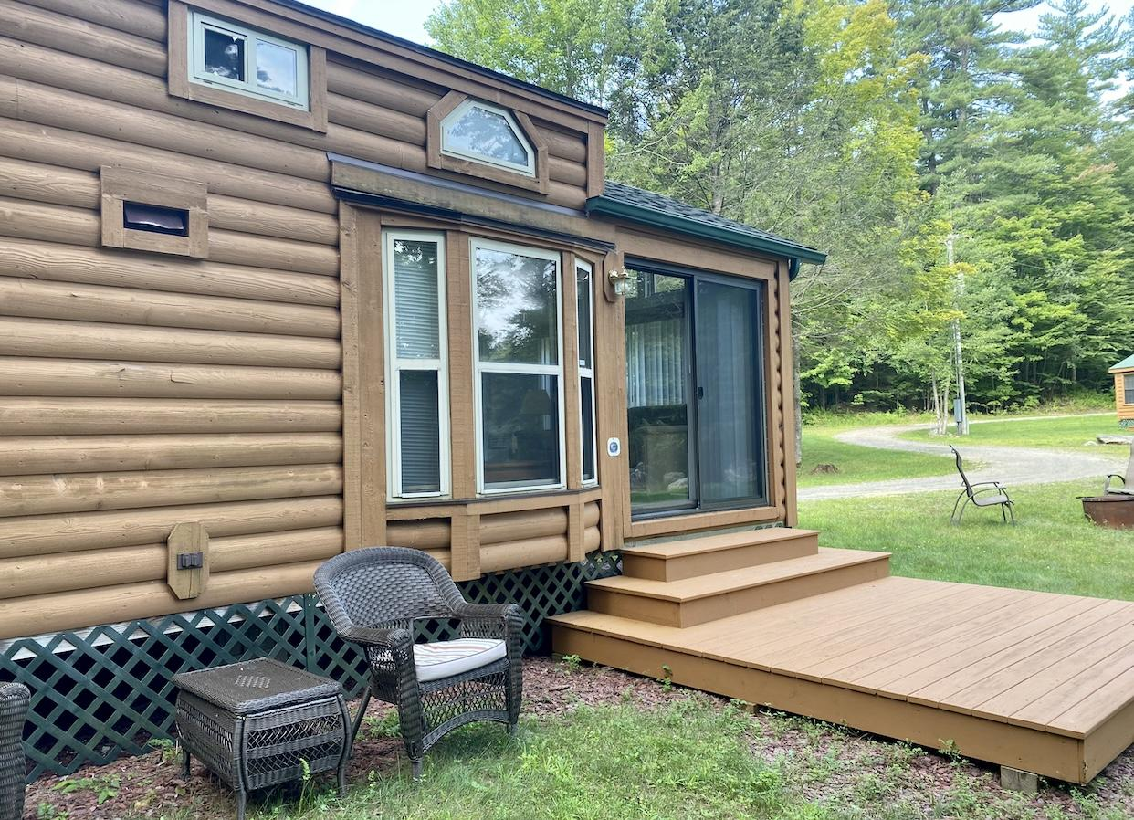
SIDE DECK

Slide 3
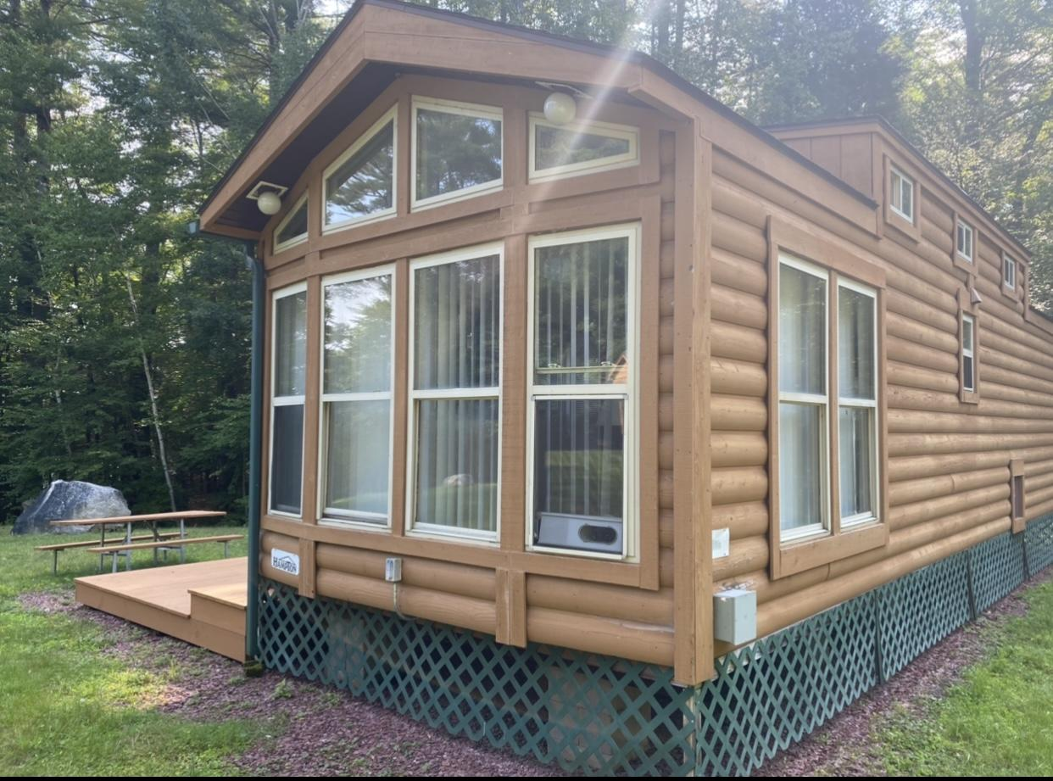
FRONT WINDOW

Slide 4
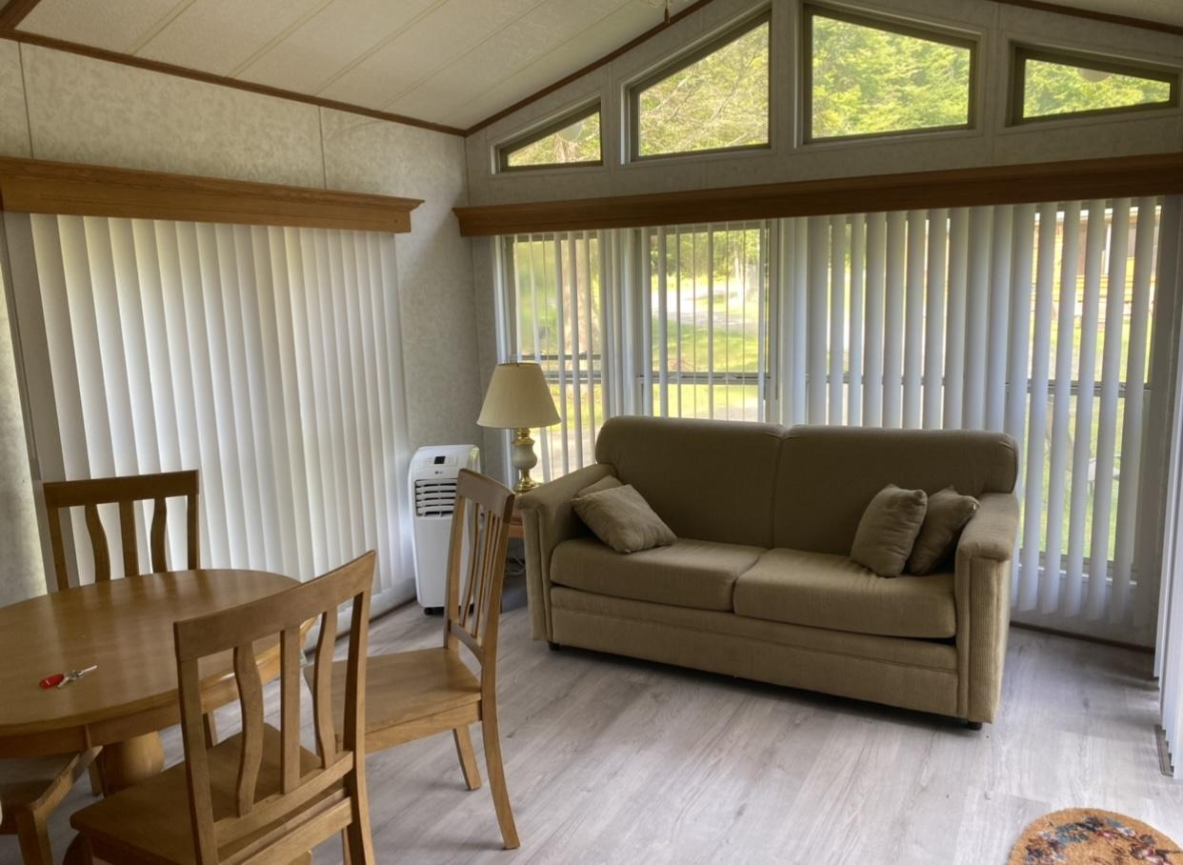
LIVING ROOM/DINING ROOM

Slide 5
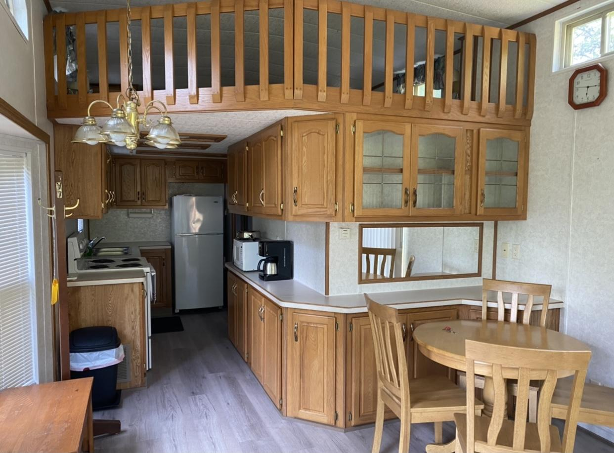
KITCHEN/DINING ROOM

Slide 6
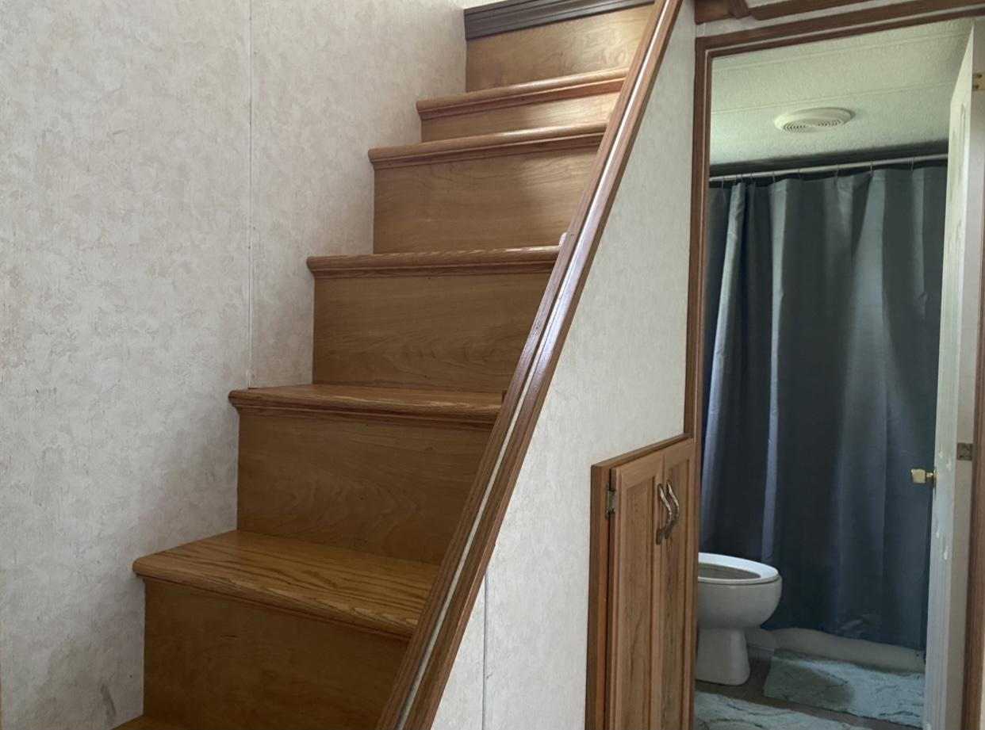
BATHROOM/STAIRS UP TO THE LOFT

Slide 7
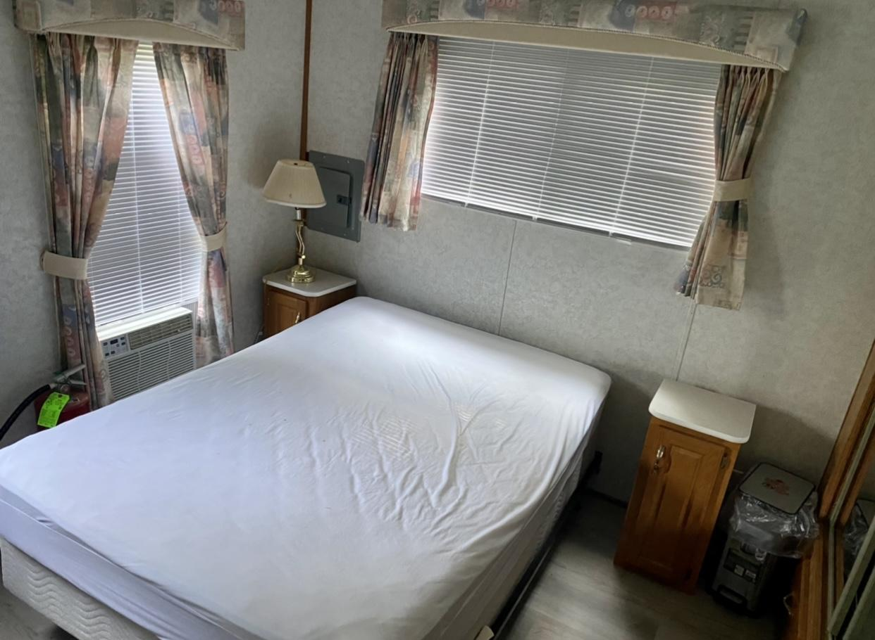
BEDROOM 1/ FULL BED

Slide 8
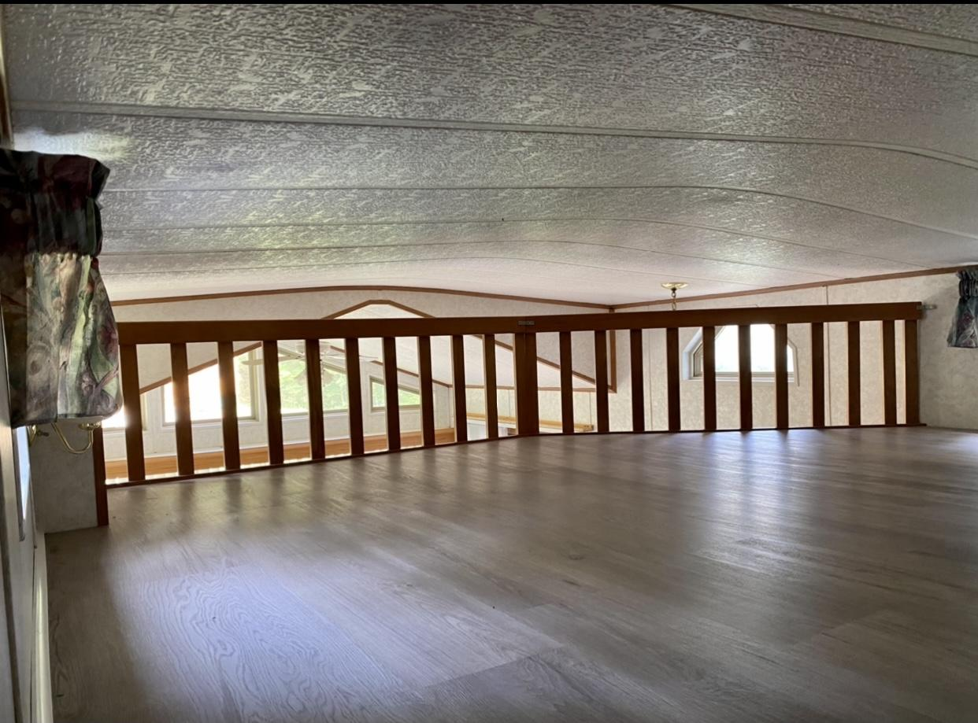
LOFT AREA

Slide 9
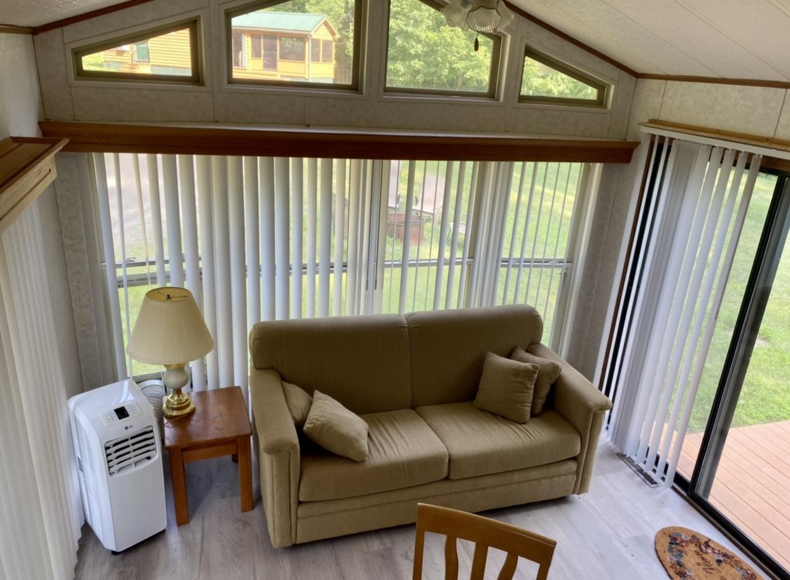
VIEW FROM LOFT AREA

