Slide 1
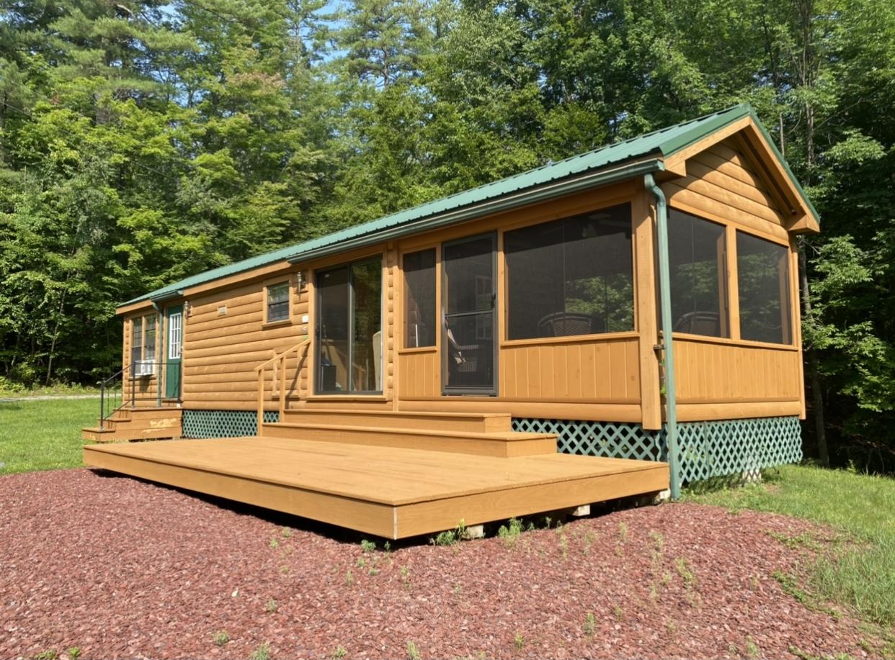
MT VERNON CABIN

Slide 2
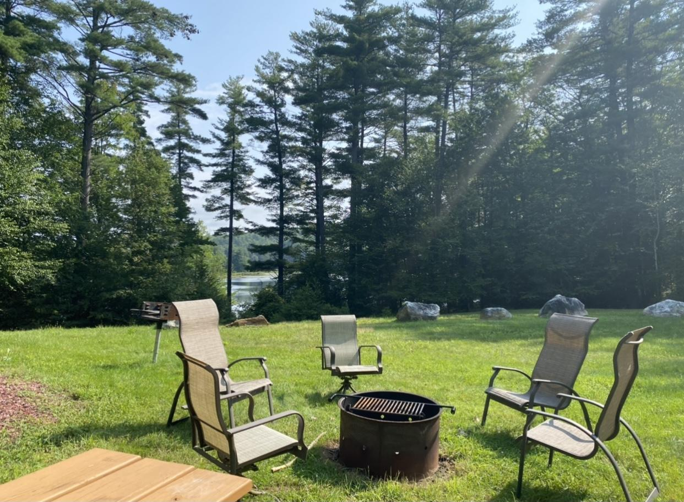
OUTDOOR SEATING/FIRE PIT

Slide 3
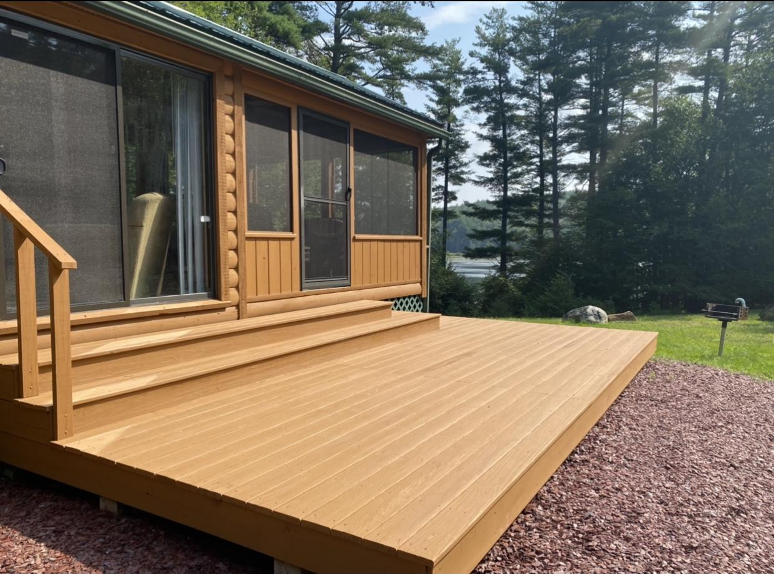
DECK

Slide 4
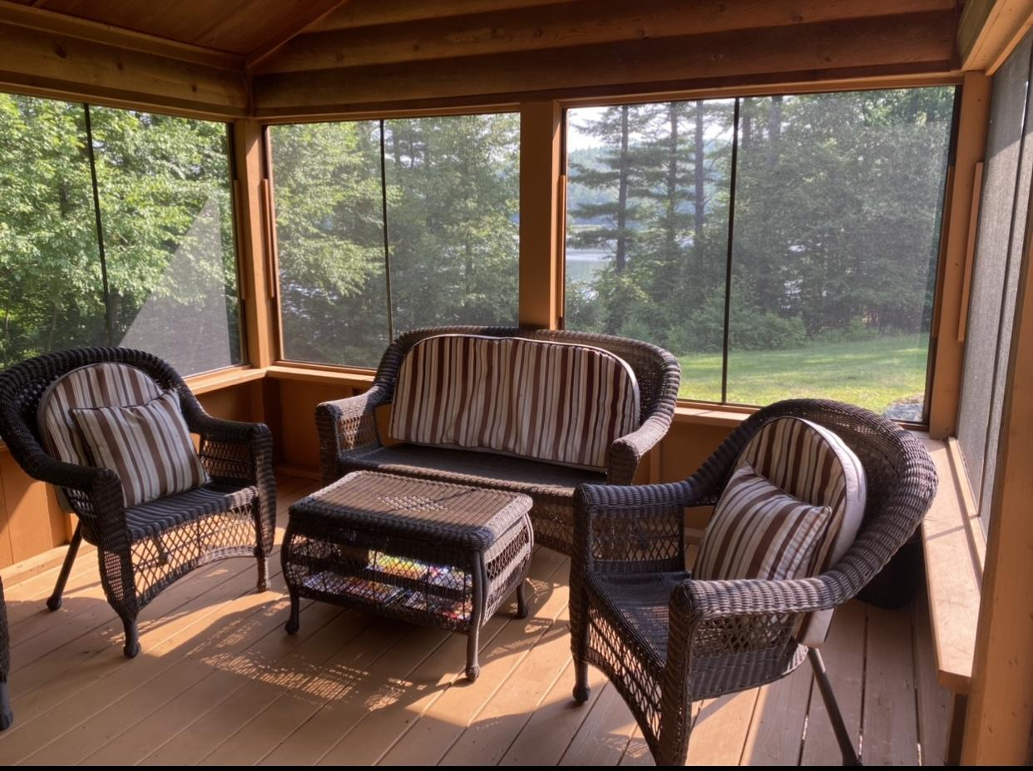
SCREENED PORCH SEATING

Slide 5
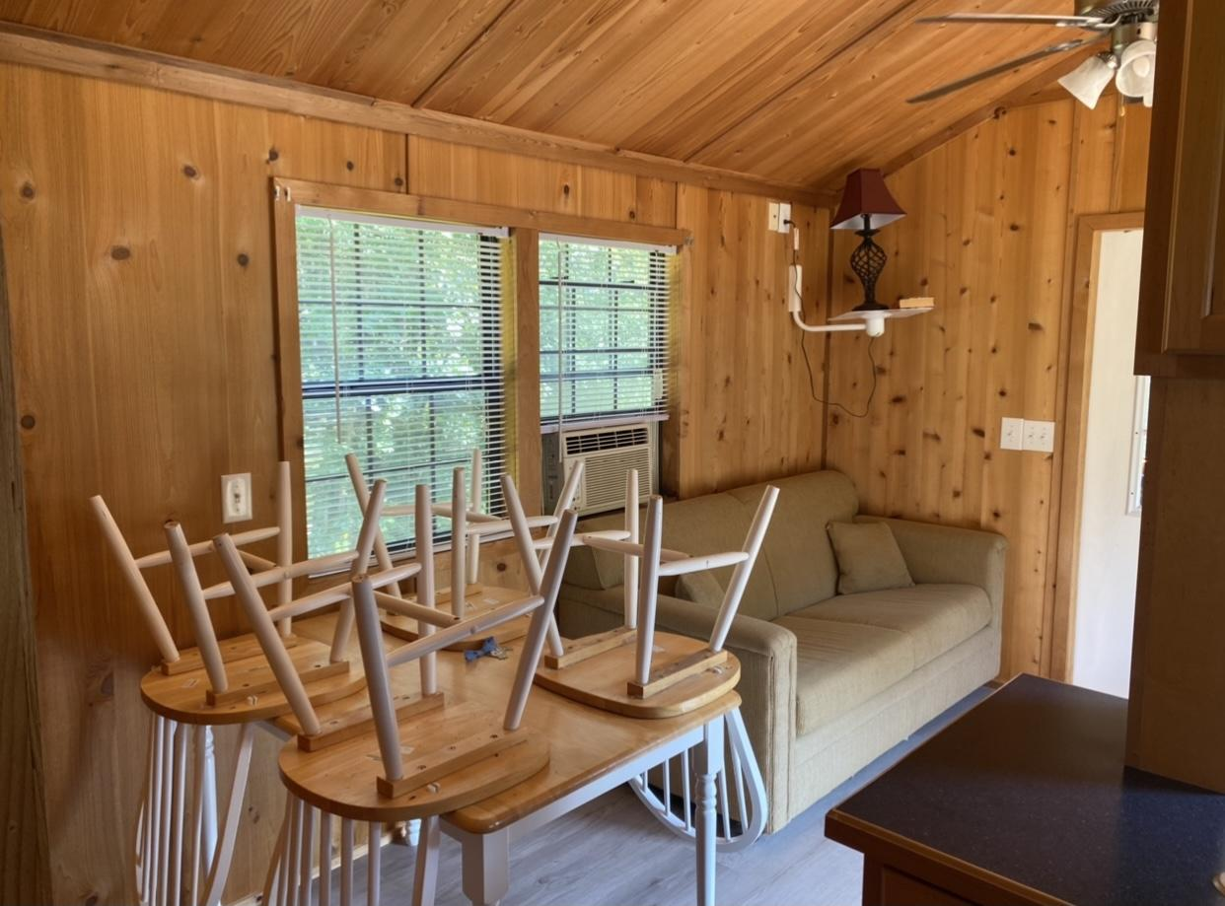
DINING ROOM/LIVING ROOM

Slide 6
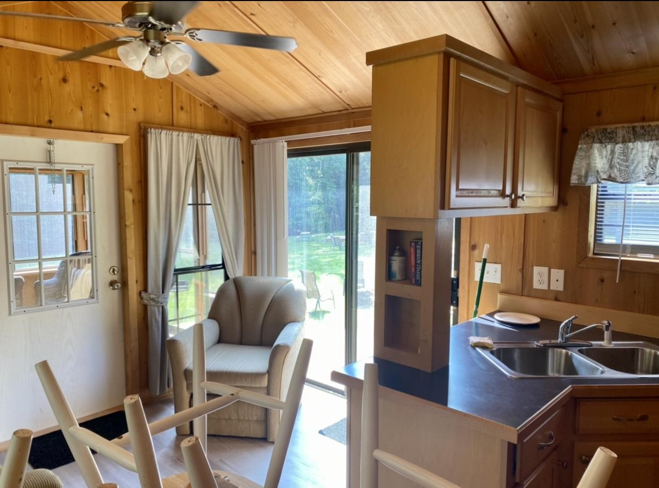
LIVING ROOM/KITCHEN

Slide 7
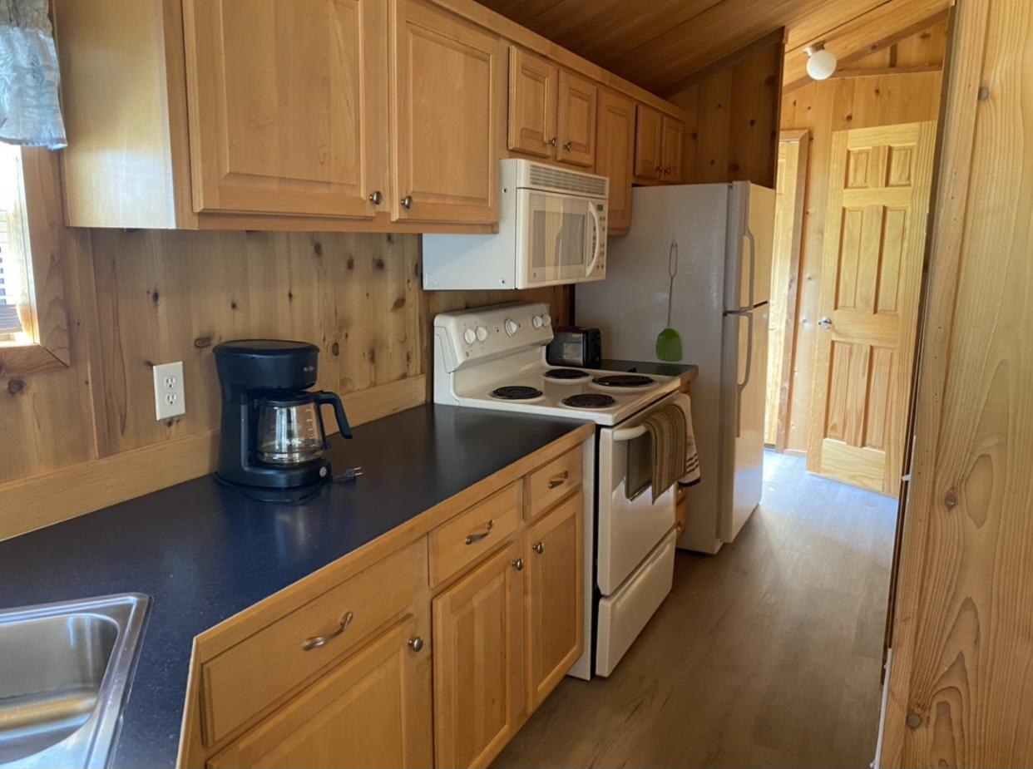
KITCHEN

Slide 8
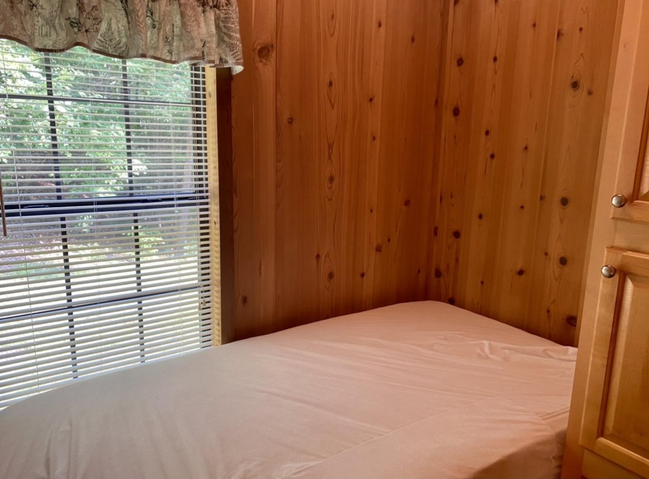
BEDROOM 1/TWIN BED

Slide 9
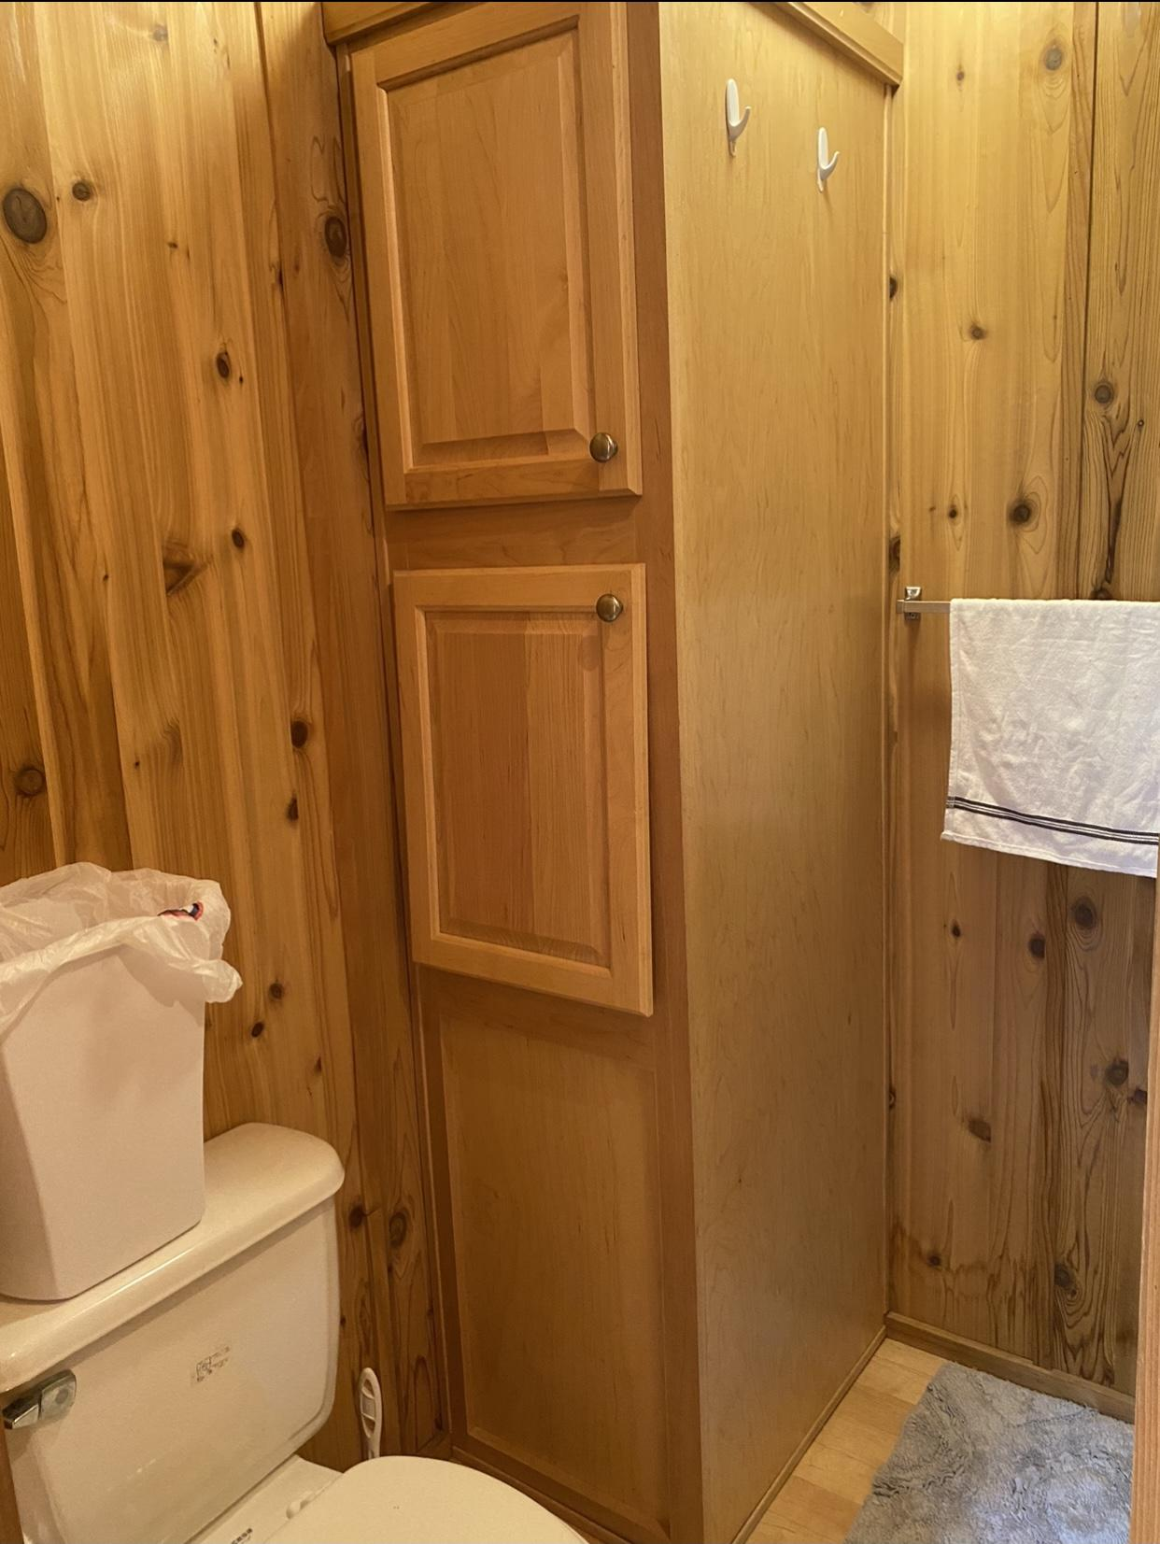
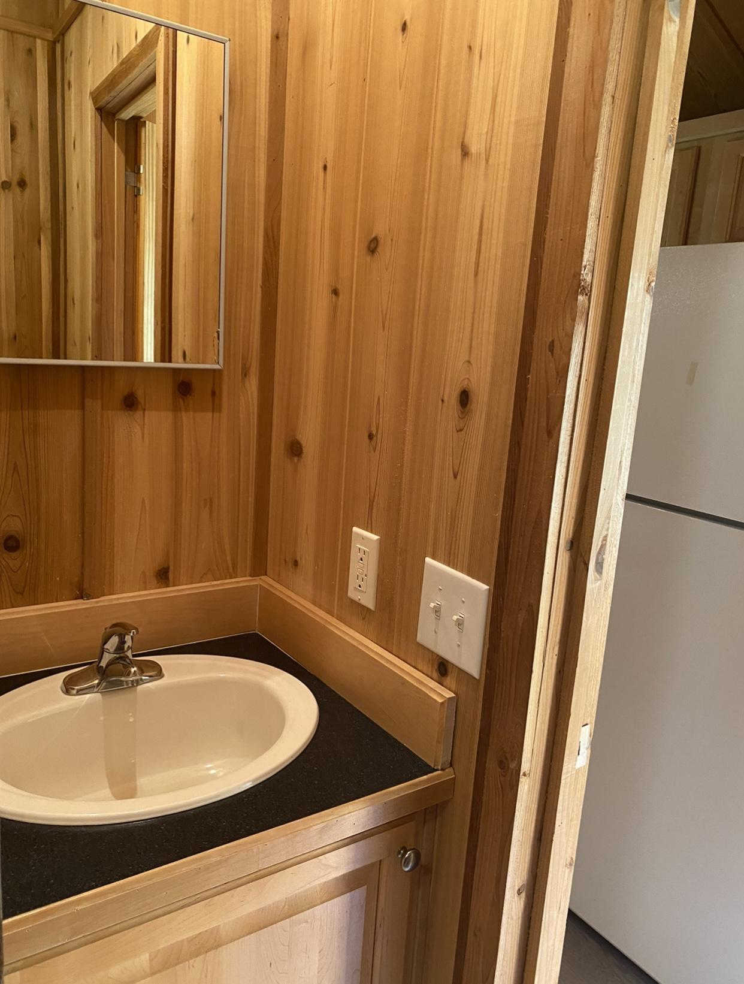
BATHROOM

Slide 10
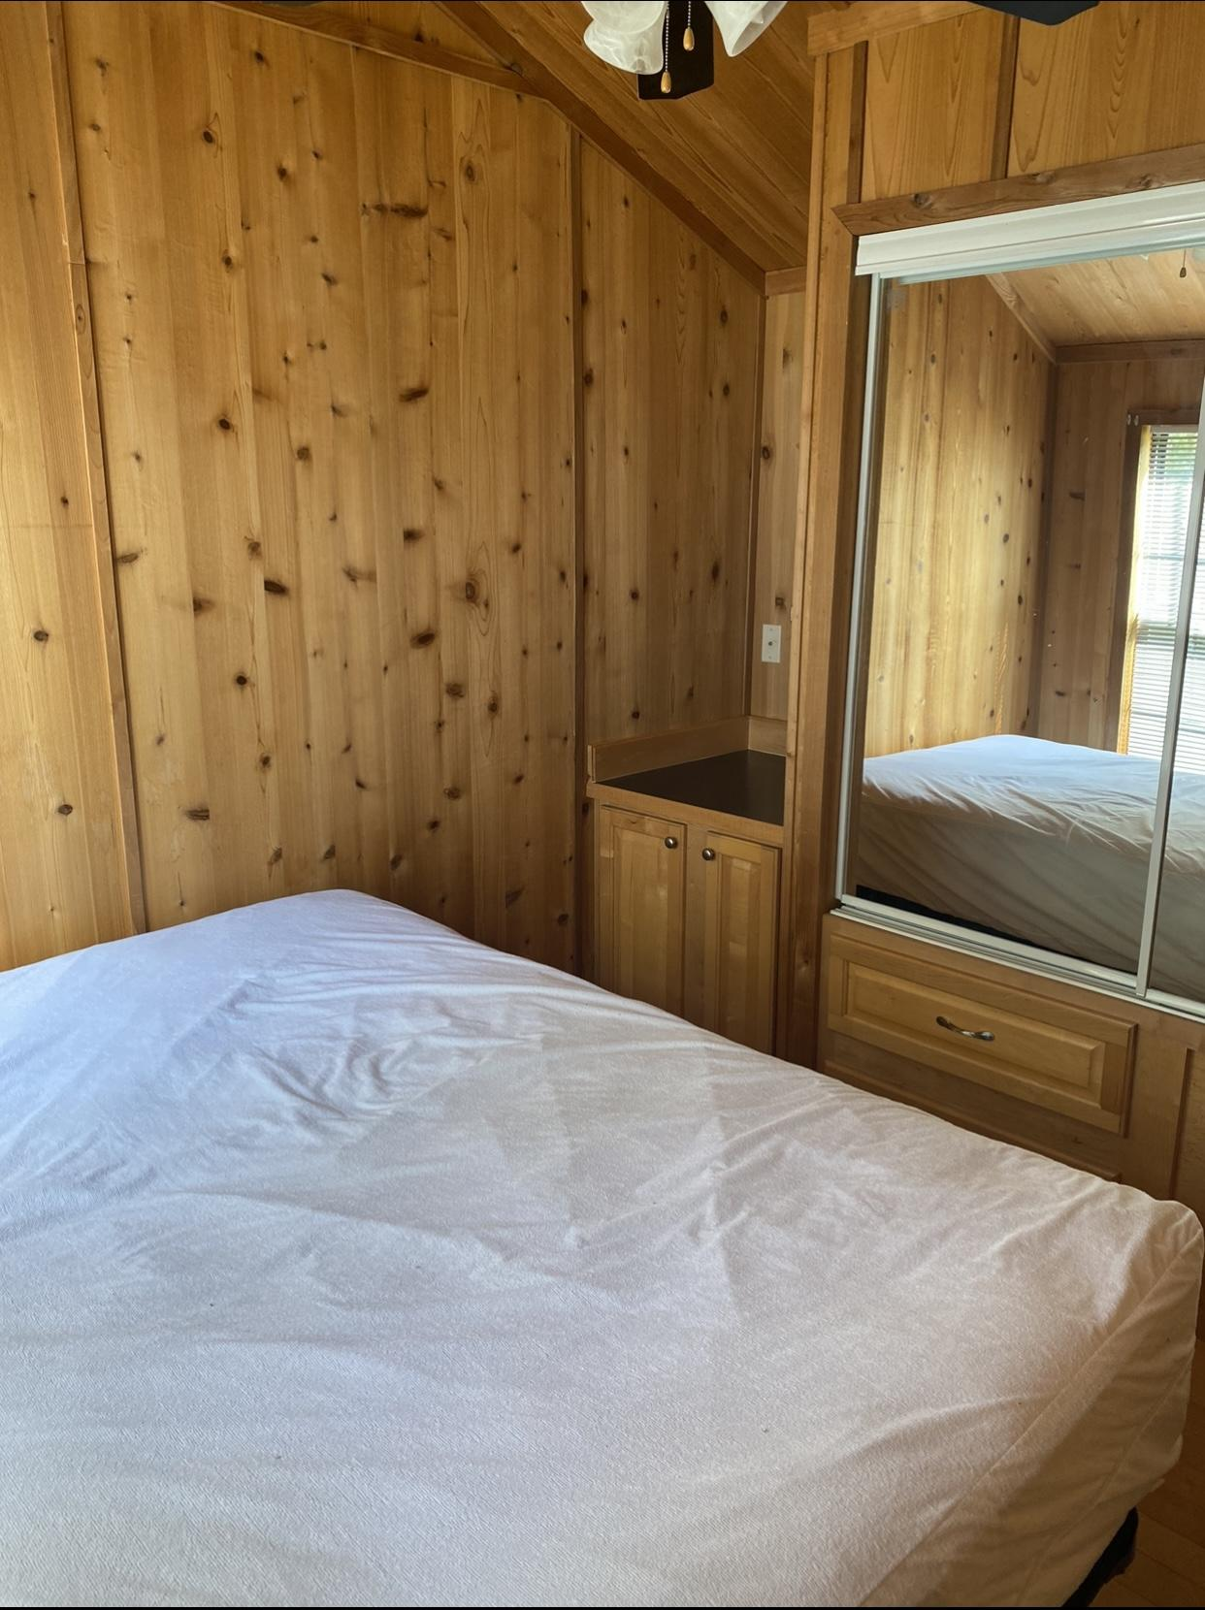
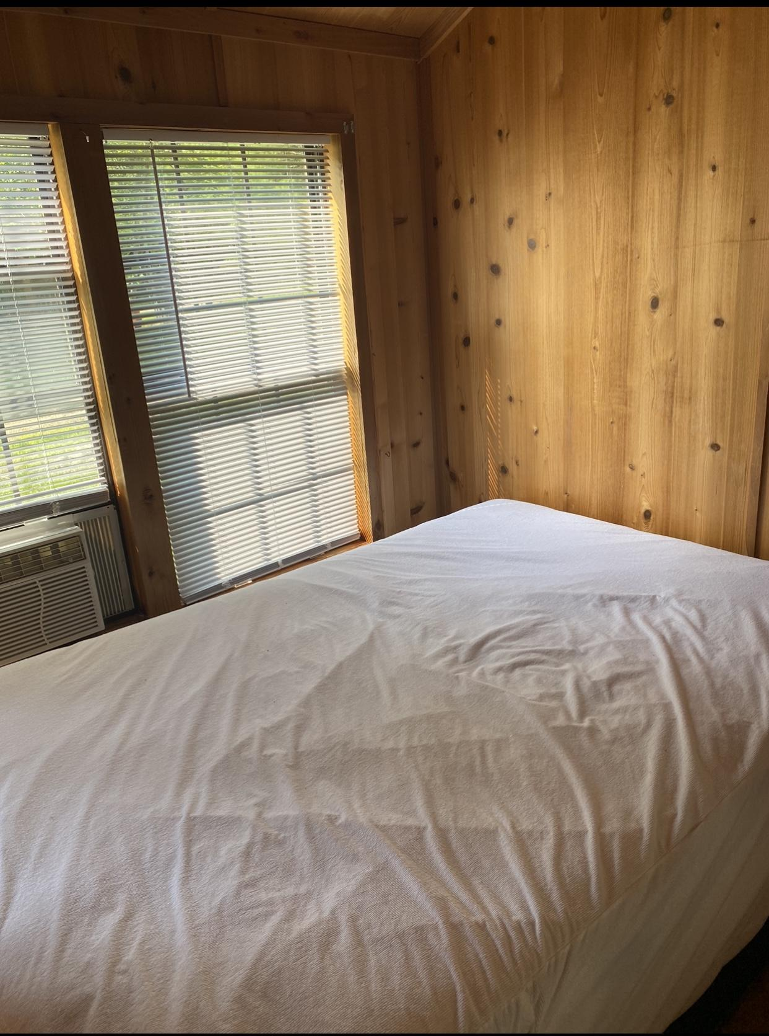
BEDROOM 2/FULL BED

