Slide 1
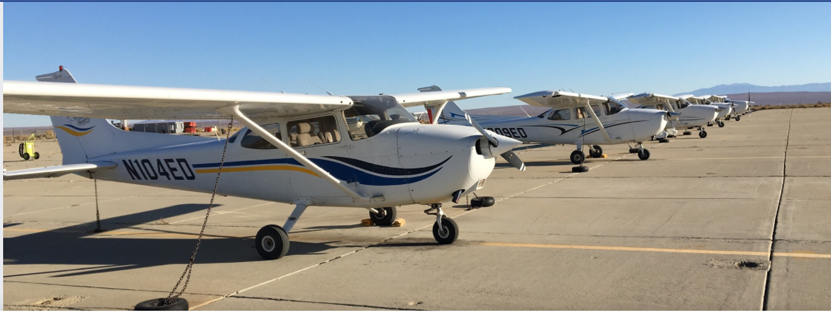
412th Operations Support Squadron
AeroClub at Main Base

Slide 2
RWY 23 Rosamond Departure
Depart at or below 3300’ MSL. Turn north-westbound and head towards the Golf Course. Once north of Rosamond Blvd, continue westbound while remaining north of Rosamond Blvd. (Expect early turns toward the golf course to expedite operations on 23L/05R).
Rosamond Blvd 3300’ MSL

Slide 3
RWY 05 Rosamond Departure
Depart at or below 3300’ MSL. Turn northbound and make a left downwind departure. Once north of Rosamond Blvd, continue westbound while remaining north of Rosamond Blvd. (Use caution, route goes under the approach corridor)
Arrival Traffic Flow
Rosamond Blvd 3300’ MSL

Slide 4
RWY 23 Buckhorn Departure
Depart at or below 3300’ MSL. Tower will issue left turnout to remain 1 mile south of the extended centerline for runway R23L and report Buckhorn.
1 Mile South of centerline 3300’ MSL

Slide 5
RWY 05 Buckhorn Departure
Depart at or below 3300’ MSL. Tower will issue right turn for a right downwind departure. Remain 1 mile south of the extended centerline for runway 5R and report Buckhorn.
Arrival Traffic Flow
1 Mile South of Final 3300’ MSL

Slide 6
RWY 23 Lancaster Departure
Depart at or below 3300’ MSL. Fly runway heading until passing Lancaster Blvd. Passing Lancaster Blvd request left turnout. Remain west of Lancaster Blvd and report “Sled Tracks”.
Lancaster Blvd 3300’ MSL

Slide 7
RWY 05 Lancaster Departure
Depart at or below 3300’ MSL. Tower will issue either a left or right downwind departure depending on traffic. Once west of Lancaster Blvd request left turnout (05L) . Outbound report “Sled Tracks”.
Lancaster Blvd 3300’ MSL

Slide 8
RWY 23 Rosamond Arrival
Proceed inbound at or below 3300’ MSL. Remain south of Rosamond Blvd and enter the right downwind for Runway 23R. (Use caution, route goes under the departure corridor) Expect hold over bend in the road.
Rosamond Blvd 3300’ MSL
Departure Traffic Flow

Slide 9
RWY 23 Buckhorn Arrival
From Buckhorn remain at or below 3300’ MSL and 1 mile south of the extended centerline for runway 23L. From Buckhorn, report midfield left downwind for sequence update. Expect hold over Buckhorn.
1 Mile South of Final 3300’ MSL

Slide 10
RWY 05 Buckhorn Arrival
From Buckhorn remain at or below 3300’ MSL and 1 mile south of the extended centerline for runway 5R. From Buckhorn, report approaching Lancaster blvd for landing clearance.
1 Mile South of Final 3300’ MSL

Slide 11
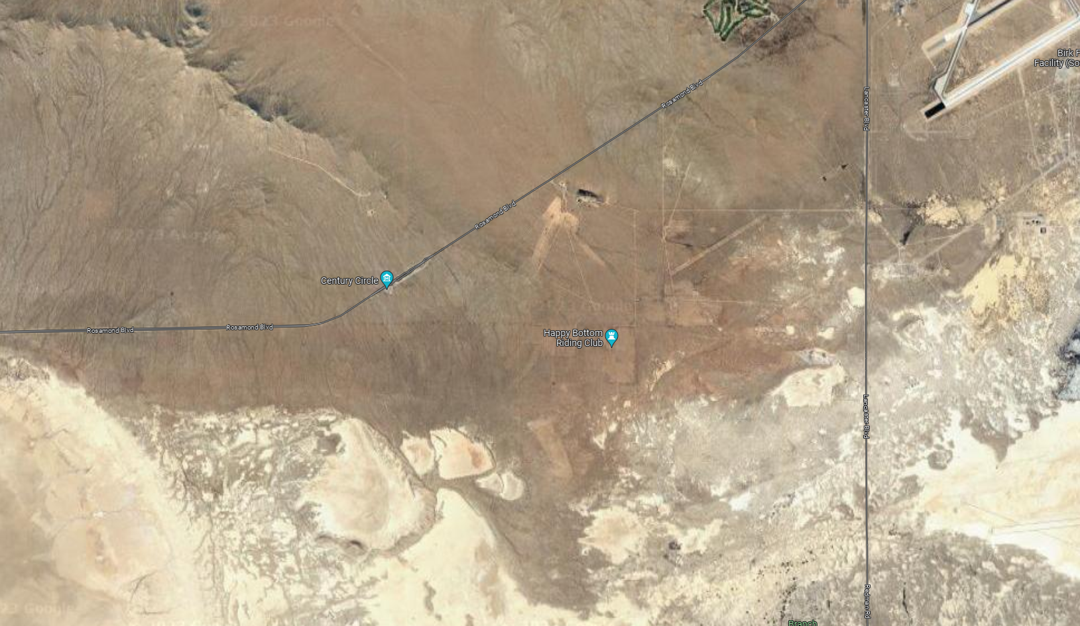
Buckhorn Arrival Holding Area
If instructed to hold over “Buckhorn”, aircraft should make left turns

Slide 12
RWY 05 Rosamond Arrival
Proceed inbound at or below 3300’ MSL remaining south of Rosamond Blvd. Report abeam golf course and start your base turn. (Use caution, route goes under the approach corridor)
Arrival Traffic Flow
Rosamond Blvd 3300’ MSL

Slide 13
Rosamond Arrival Holding Area
If instructed to hold over the “Golf Course”, aircraft should make left turns
Arrival Traffic Flow
Rosamond Blvd 3300’ MSL

Slide 14
RWY 23 Lancaster Arrival
Proceed inbound at or below 3300’ MSL east of Lancaster Blvd and report over the sled tracks. Tower will instruct aircraft to hold over the sled tracks or issue arrival instructions.
Lancaster Blvd 3300’ MSL

Slide 15
RWY 05 Lancaster Arrival
Proceed inbound at or below 3300’ MSL east of Lancaster Blvd and report abeam sled tracks. Tower will provide arrival or hold instructions as necessary. EXAMPLES:
“ENTER RIGHT BASE”
“MAKE RIGHT TRAFFIC, REPORT (MIDFIELD or DEPARTURE END) DOWNWIND”
“HOLD OVER SOUTH LAKEBED”
Lancaster Blvd 3300’ MSL

Slide 16
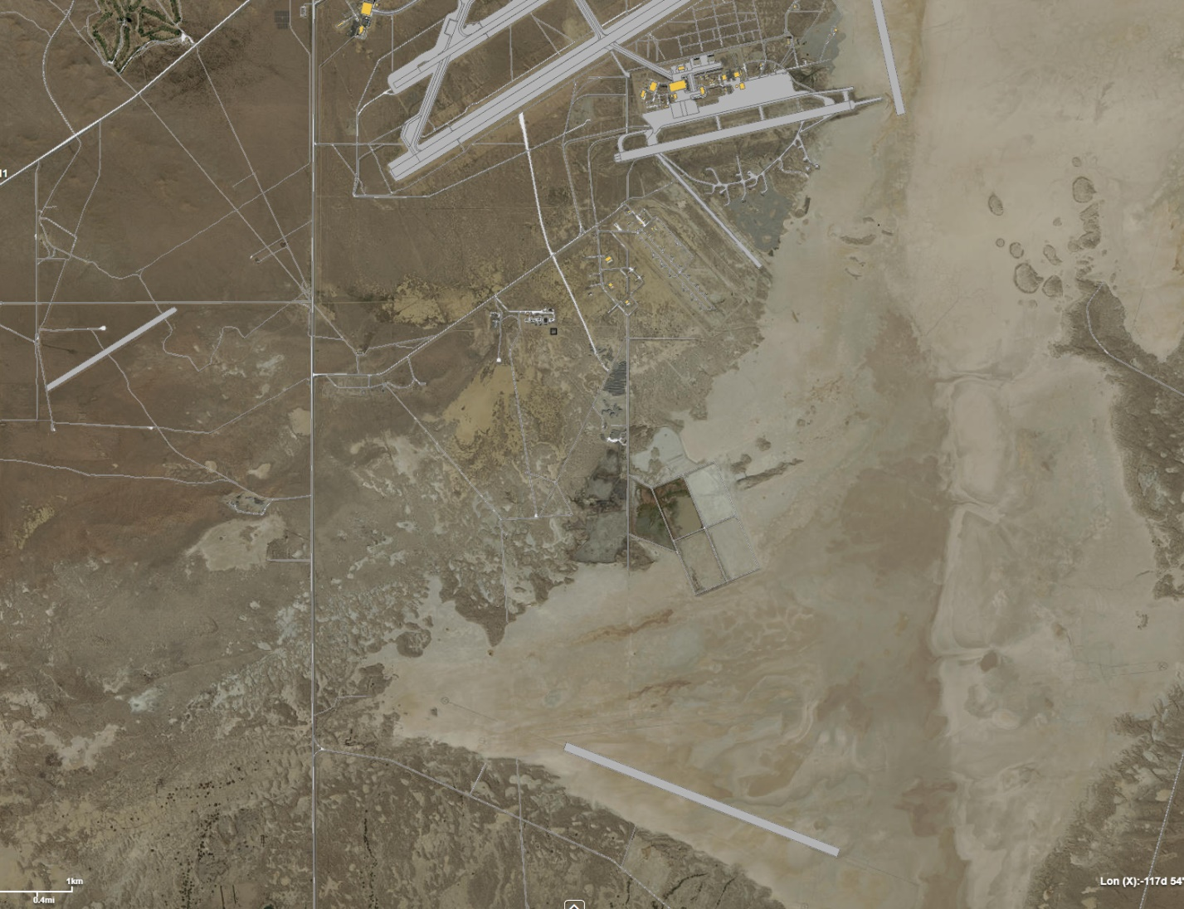
Lancaster Arrival Holding Area
If instructed to hold over “South Lakebed”, remain east of Lancaster blvd and 1 mile south of Southbase, over lakebed runway 09/27.
Lancaster Blvd

Slide 17
Opposite Direction Taxi Operations
Edwards Ground may hold aero club aircraft to the side of taxiways A, F, C, or E and allow aircraft with wingspans less than 45’ to taxi past.

Slide 18
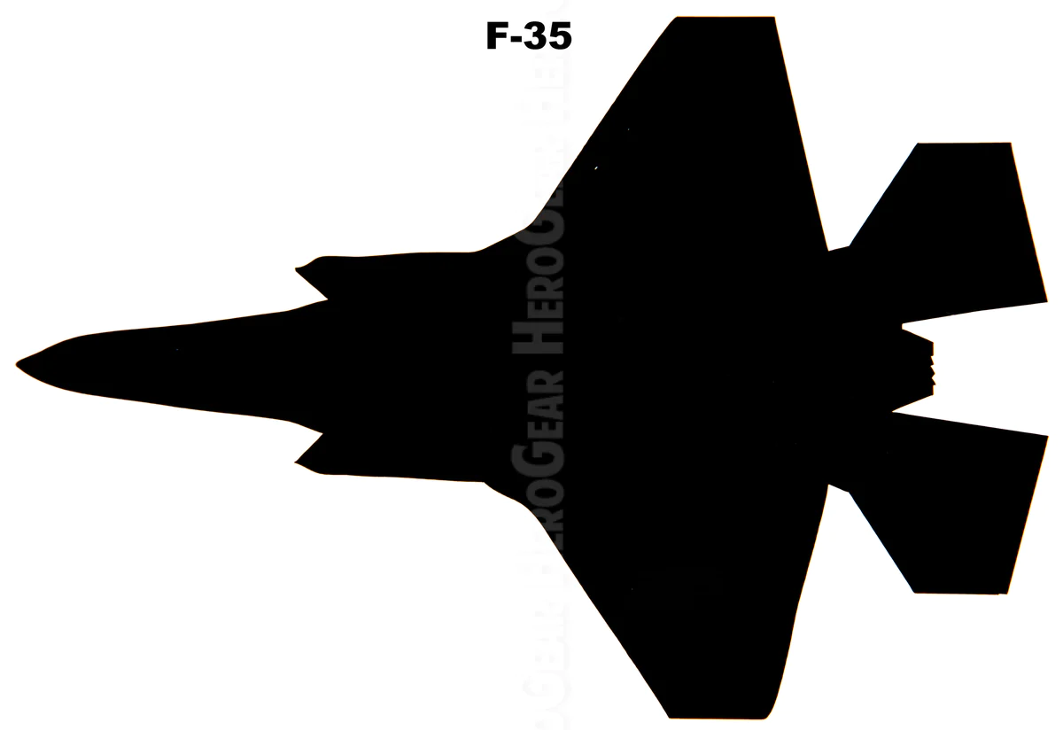
Opposite Direction Taxi Operations
Aeroclub aircraft will hold on taxiway with the outside tire on edge line while opposite direction aircraft taxies by.
Example Phraseology:
“N108ED OFFSET RIGHT AND HOLD FOR OPPOSITE DIRECTION F35”
“JESTER32 TAXI RIGHTSIDE OF TAXIWAY CHARLIE FOR OPPOSITE DIRECTION C172”
“N108ED CONTINUE TAXING”

Slide 19
Departure Procedures
The aircraft will contact Edwards Ground for taxi instructions. First request made to Ground should be requesting to taxi to the “run up” area on Ramp 1. Once complete, request to taxi to active runway.
Performing “run up” prior to entering Taxiway Bravo prevents the taxiway from being unnecessarily occupied, which slows operations (i.e. landing aircraft exiting at the end of the runway due to Bravo being unavailable)
Phraseology
Aircraft: “EDWARDS GROUND (AIRCRAFT CALLSIGN), REQUEST TAXI TO RUN UP AREA.
GROUND: “(AIRCRAFT CALLSIGN), TAXI TO RUNUP AREA VIA FOXTROT.”
AIRCRAFT: “EDWARDS GROUND (AIRCRAFT CALLISIGN), REQUEST TO TAXI TO RUNWAY 23R AT BRAVO FOR (DEPARTURE ROUTE).
GROUND: “(AIRCRAFT CALLSIGN), RUNWAY 23R AT BRAVO INTERSECTION DEPARTURE, TAXI VIA BRAVO. COPY (DEPARTURE ROUTE).
Run up

Slide 20
South/North Base Patterns
South and North Base patterns will remain at 2800’.

Slide 21
Contacts
Airfield Operation Flight: Director of Operations
Mr. Scott “CD” Crawford: 661-277-7953
1st Lt Thomas Murphy 661-277-6326
Air Traffic Control: Chief Controllers
SMSgt Katelyn “KM” Moore: 661-277-2121
Mr. Nick “NK” Booker: 661-277-2121
Airfield Management: Airfield Manager
Mr. Antoine “AL” Smith: 661-277-3808

Slide 22
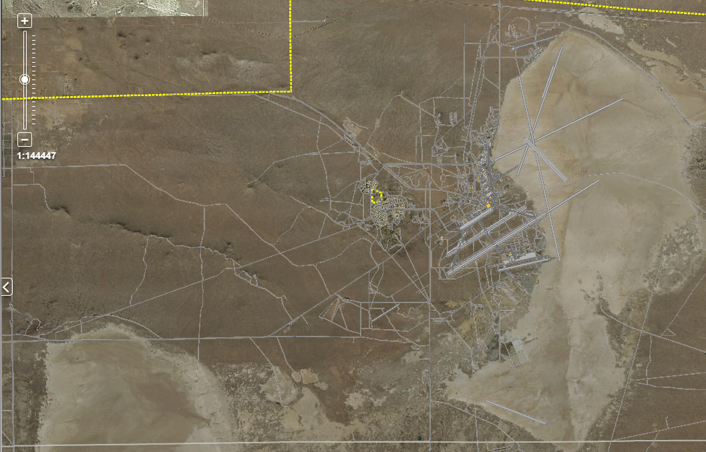
RWY 5R North Re-Entry
3300’ Departure route with North Re-Entry 4300’.
3300’ MSL
Rosamond Blvd

