Slide 1
UNITE PROGRAM
BUILDING TEAM COHESION THROUGH RECREATION
GFAFB 2023
Janessa Vageline, 747-6351(office), 739-0596 (cell)

Slide 2
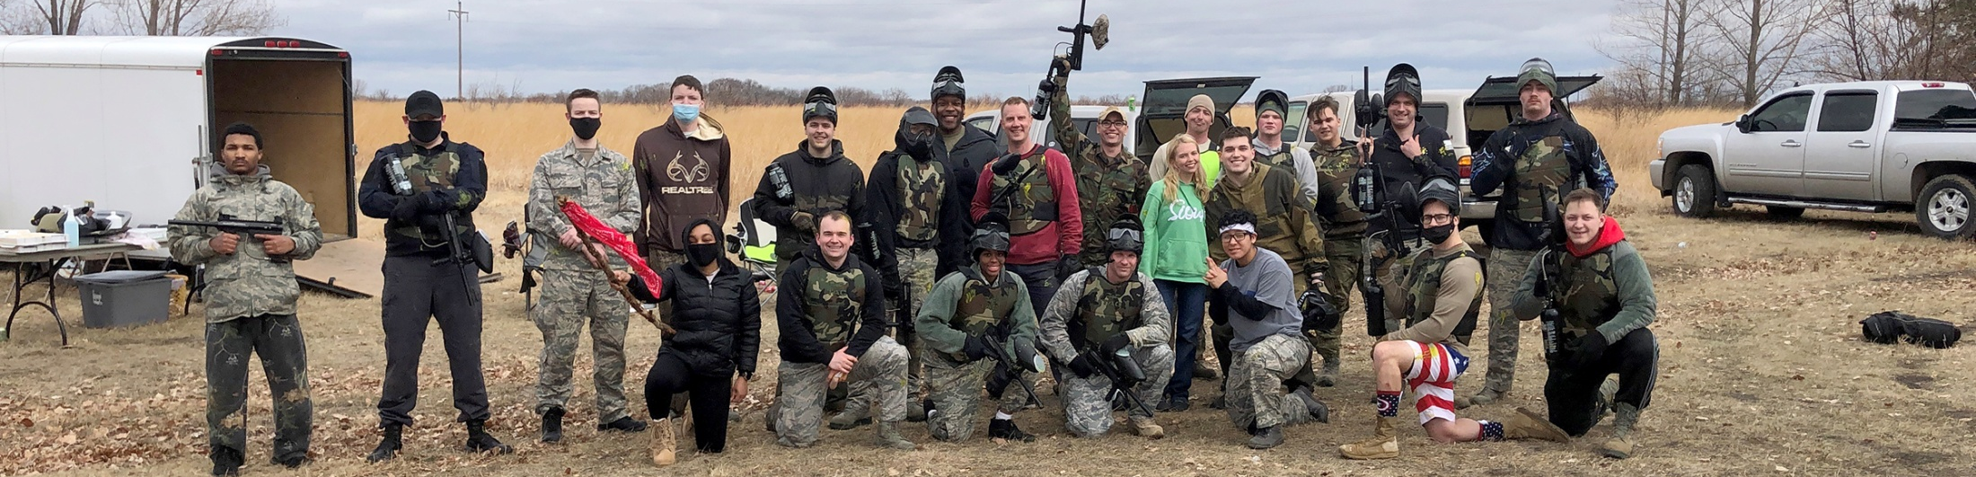
WHO’S ELIGIBLE?
All assigned Air Force and Space Force Active Duty, Reserve, Guard, and civilian (APF/NAF) members are authorized Unite funds for CY23
Dependents are welcome to participate in Unite events
It’s at the Commander’s discretion whether Unite will pay the way of dependents or not, as their expenses would come out of your CY23 allocation

Slide 3
INCLUSION
Commanders should make every effort to ensure all authorized members of a unit have an opportunity to participate in Unite events
Events cannot be divided based on age, race, gender, or religion
They may be divided by work center, flight, shift, shop, etc.
Events CAN NOT be held for dependents only

Slide 4
SHOW ME THE MONEY!
RECREATION
$13.50/PERSON
FOOD + BEVERAGE
$5/PERSON

Slide 5
FUNDING GUIDELINES
Funds can be used on or off the installation
Unite is not a food & beverage program
Unite is not a reimbursement program
Your C3 will make Unite purchases on your behalf
Purchases are typically made over the phone or online
Any overages are your responsibility and will be paid out of pocket or with booster club funds
NEW! We must have a completed 889 form for any off-base establishment before a transaction is made
Purchases are tax exempt (our code is E-1001)
Receipts are required (text/email me a copy)

Slide 6
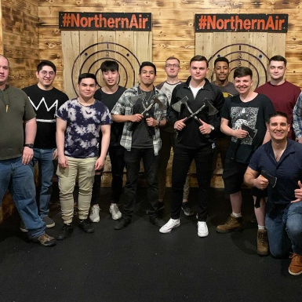
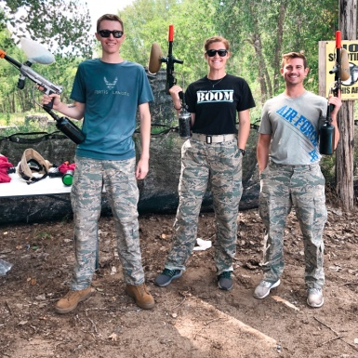
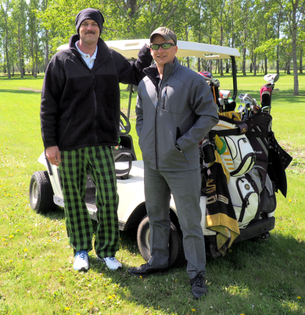
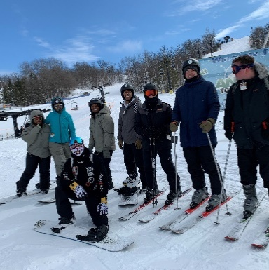
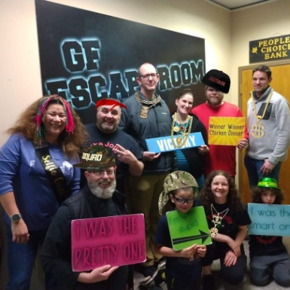
RECREATION IDEAS
Axe Throwing
Batting Cages
Bowling
Broom Ball
Canoeing
Curling
Driving Range
Escape Rooms
Fishing
Frisbee Golf
Go Karts
Golf
Kayaking
Laser Tag
Ludo Sports
Movie Theater
Paintball
Paint Party
Pickle Ball
River Tubing
Skiing
Snowshoe
Trampoline Park
Wrecking Ball
Yoga
VOLUNTEER/FREE
Fun Run
Highway Cleanup
Kickball
Minute-to-Win-It
Softball
Food Bank

Slide 7
FOOD + BEVERAGE IDEAS
Buy groceries Have a burger burn or picnic
Order pizza
Dine-in Your funds won’t go as far, but you are welcome to use your funds at restaurants, fast food joints, coffee shops, and the like
Theater Snacks Use your funds to get a popcorn and soda at the movie theater!

Slide 8
Unauthorized…
EVENTS
December holiday parties
End of year events
Balls/banquets
Dining-outs/Combat dining in/out
SQ training/meetings
Change of commands
Eating events
Promotions/retirements
Base wide special events
PURCHASES
Alcohol
Equipment*
Supplies for volunteer events
Cleaning supplies/PPE
Fees to cover damages, late fees, or insurance
Prizes, gift cards, or promotional items
Gambling
Notes:
You can host events in December, just not Christmas parties. *Equipment may be rented.

Slide 9
EVENT TIDBITS
Shop-level events tend to better attended and more engaging than squadron wide events
A traditional picnic is not an event.
You can have a picnic with Unite funds, but you must make recreation the focus instead of food. You could add a softball tournament or a fun run for example.
Your expected attendance sets the event budget
If you expect 20 people to participate, Unite will cover up to $270 for recreation and up to $100 for food
If only 15 people show up, the venue may still charge you for 20 and that’s okay. You may use the extra funds to reduce your out-of-pocket costs, if applicable. If the venue only charges you for actual attendees, the remaining funds will stay in your Unite bank for future use.

Slide 10
HOSTING AN EVENT
Plan your event and complete the request form
Have your leadership sign the form and email it to: janessa.vageline.1@us.af.mil
I’ll submit it to the Air Force Services Center (AFSVC) for approval and notify you once it is complete
Please allow up to 5 business days
Email me invoices or call me for payment
This might be before, during, or after your event, depending on what the venue prefers
Host your event, take pictures, and have fun!
Complete the after-action report (AAR) and email it to me with 1-3 event photos within 5 business days of your event.
Notes:
Include one group shot.

