Slide 1
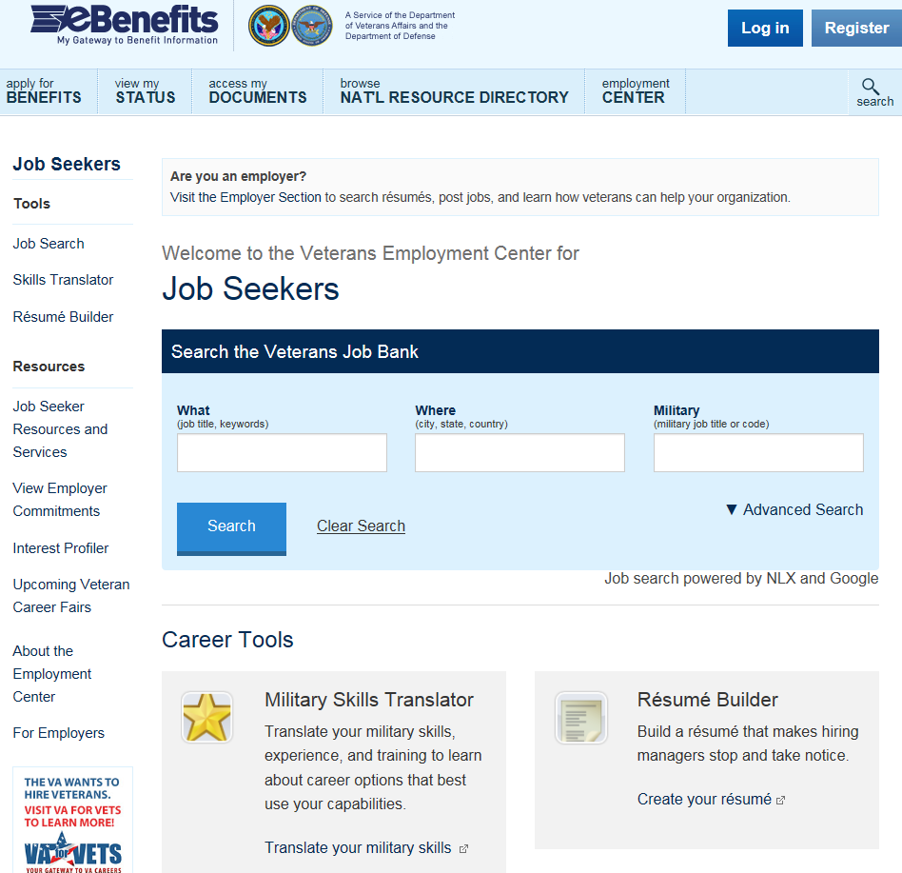
Veterans Employment Center
Single online source to connect with civilian career opportunities
Build a Profile
Translate Your Skills
Search for Jobs
www.ebenefits.va.gov/ebenefits/job

