Slide 1
86th Security Forces
Resource Protection Office
Anti-Robbery Training

Slide 2
Anti-Robbery Training
WHO needs Anti-Robbery Training:
Supervisors and personnel who handle funds, and Arms, Ammunition and Explosives (AA&E), and Narcotics must become proficient in the proper methods and appropriate actions for reacting to robbery situations.
When do you conduct Anti-Robbery Training:
Initially upon assignment and annually thereafter.
**Remember, every person performing cash handling operations or having access to AA&E operation is a potential robbery victim.

Slide 3
Anti-Robbery Training
Actions during an actual robbery.
Comply with the robber’s demands. Hand over only what is demanded. Do not argue!
Hand over whatever is demanded, but ONLY what is demanded
Don’t tell the suspect “Don’t rob me, rob John, he has more money than I do”
DO NOT resist or do anything that would endanger your life of the lives of others
NOTE: Armed personnel protecting arms, ammunition and explosives (AA&E), have an inherent responsibility to protect resources dangerous to others. Armed personnel protecting AA&E are not required to comply with the robber’s demands.
Continued…
Notes:
NOTE: Armed personnel protecting arms, ammunition and explosives (AA&E), have an inherent responsibility to protect resources dangerous to others. Armed personnel protecting AA&E are not required to comply with the robber’s demands.

Slide 4
Anti-Robbery Training
NEVER try to subdue or apprehend the suspect
He or she may be a little crazier than the average person
Obey the commands of the suspect explicitly.
Experience shows that being cooperative gives the suspect a false sense of security and the suspect may do or say something which will help in the investigation of the crime.
Continued…

Slide 5
Anti-Robbery Training
As soon as it can safely be done, notify all co-workers in the facility that a robbery has occurred
A good example of this would be to establish a code within your facility such as “CODE 13”. After the suspect leaves, communicate with your co-workers, “Code 13 at register 4”.
Stop all business transactions
If a robbery occurs, every employee is responsible in making sure these steps are completed
Don’t leave the “victim(s)” to fend for themselves; Try and help out as much as possible without getting in the way

Slide 6
Anti-Robbery Training
Activate your Duress Alarm (if one is available)
The alarm should be activated as soon as the suspect leaves the area AND should be done when it does not endanger the life of the person activating the alarm, the lives of innocent bystanders or customers
A follow-up telephone call should be made immediately to the Base Defense Operations Center (BDOC) using the CRIME STOP number:
If NO DURESS is available
Notify the BDOC via CRIME STOP, immediately after the suspect departs the area

Slide 7
Anti-Robbery Training
CRIME STOP NUMBER:
DSN- 112
CIV- 112

Slide 8
Anti-Robbery Training
Reporting the robbery to Law Enforcement
Any specific information on the description of the individual(s) or hostages should be given to the Law Enforcement Desk at this point
Any information which can be gained as to the method of travel (foot or car) is extremely valuable
Attempt to obtain as discreetly as possible, type of vehicle, color, model, license plate number, direction of travel, and any other information
If using a vehicle, try and see who is driving or if anyone else is in the vehicle

Slide 9
Anti-Robbery Training
Provide Law Enforcement as many facts as possible
Example: “This in an emergency. This is Mrs. Jones at the NCO Club. I am reporting a robbery. Two white males have robbed the cashiers cage. They are in a Black Nissan, license plate RR 9857”
Use AF Form 439, Robbery Checklist, as a guide and follow any instructions given from BDOC over the phone
DO NOT HANG UP THE TELEPHONE until told to do so by BDOC. Always keep the line open until told otherwise
Notes:
Try to form a mental picture of the robber making note of any noticeable details.

Slide 10
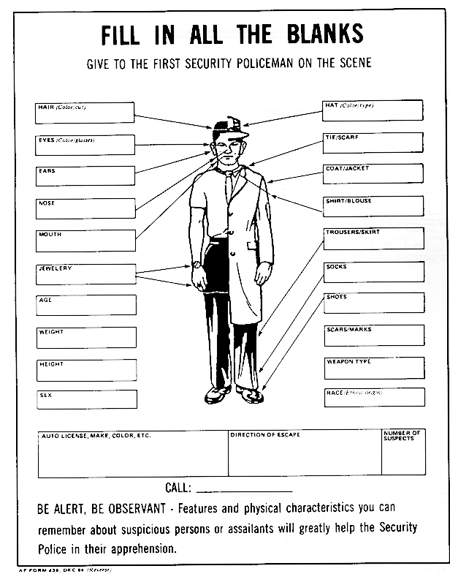
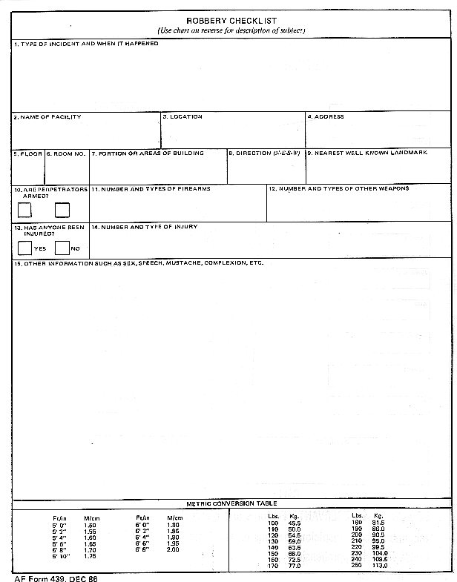
Fill out the AF Form 439, Robbery Checklist
112

Slide 11
Anti-Robbery Training
Immediately close the facility
If you don’t have keys for the door(s), posting an individual at the door is considered securing the facility
The Security Forces/AFOSI/CID agents should be met outside by the person in-charge of the facility OR a hostage situation will be assumed
The person in-charge and Security Forces/AFOSI/CID should be the only people allowed to enter the facility after the robbery has occurred
DO NOT allow anyone else to enter or leave the facility
Remember, everyone in the facility is a potential witness to the crime

Slide 12
Anti-Robbery Training
Protect the Crime Scene
Protect any evidence that might be available
Do not touch or allow anyone else to touch anything that might have been left by the suspect or in the area used by the suspect
If someone approaches an area that you feel the suspect may have touched or came in contact with, tell that individual to step away from the area. Let him/her know the area is part of the Crime Scene

Slide 13
Anti-Robbery Training
DO NOT discuss the incident
Refrain from discussing the incident with anyone except Security Forces/AFOSI/CID or other investigators. Also, attempt to keep others from discussing the incident among themselves.
This tends to confuse the facts more than anything else. Sometimes people invariably get the facts mixed up with opinions, not necessarily their own

Slide 14
Anti-Robbery Training
Keep in mind, INFORMATION IS THE KEY
The more information you can provide to BDOC personnel, the more likely it is the suspect will be apprehended.
REMEMBER: Your foremost duties in a robbery situation are:
To comply with the demands of the individual, remember every
possible detail of the individual and incident, and communicate
what you remember to BDOC personnel

Slide 15
Anti-Robbery Training
The Resource Protection office is also available to conduct training or provide assistance for facilities. You may contact the resource protection office by calling 478-2230.

Slide 16
Anti-Robbery Training
QUESTIONS?

