Slide 1
86 FSS/FSR Resource Protection Internal Controls Training Program
Welcome To 86FSS-FSR
NON-Appropriated Funds Management Internal
Controls (MICP) Program
This training workshop explains the controlling
process, and outlines procedures for the control,
protection, and loss prevention of cash and other
nonappropriated fund (NAF) assets.

Slide 2
86 FSS/FSR Resource Protection Program Training
In the following slides, we will discuss:
What are Internal Controls?
Why an Internal Controls program?
Vital Components of internal Controls
Types of Internal Controls
What is the process?
Who is Responsible
Summary

Slide 3
Management Internal Controls Program
WHAT IS THE MICPROGRAM
The MICProgram’s purpose is to ensure internal controls are in place
and are effective. These internal controls are operational checks and
balances that prevent loss due to fraud, waste, abuse, and
mismanagement of government resources.

Slide 4
Required by regulation
AFMAN 34-202
AFMAN 34-212
OI 34-217
The MICP is a good management tool to evaluate administrative, operational, programmatic, accounting and financial management functions
The expectation is to help prevent fraud, waste, abuse and mismanagement in Federal Government operations and provide quality products and services
Personnel in the Nonappropriated Fund Accounting Office (NAF AO) and in NAFI activities must follow internal control procedures specified in Air Force directives. At a minimum, all Air Force NAFI personnel associated with administration, managing, handling, safeguarding, and accounting for NAF assets, including cash, should be familiar with AFMAN 34-202, Procedures For Protecting Nonappropriated Funds Assets and AFMAN 34-212 Control Procedures For Protecting NAF Assets.
Management Internal Controls Program
WHY AN INTERNAL CONTROLS PROGRAM?
Required by regulation
AFMAN 34-202
AFMAN 34-212
OI 34-217
The MICP is a good management tool to evaluate administrative, operational, programmatic, accounting and financial management functions
The expectation is to help prevent fraud, waste, abuse and mismanagement in Federal Government operations and provide quality products and services
Notes:
Personnel in the Nonappropriated Fund Accounting Office (NAF AO) and in NAFI activities must follow internal control procedures specified in Air Force directives. At a minimum, all Air Force NAFI personnel associated with administration, managing, handling, safeguarding, and accounting for NAF assets, including cash, should be familiar with AFMAN 34-202, Procedures For Protecting Nonappropriated Funds Assets and AFMAN 34-212 Control Procedures For Protecting NAF Assets.

Slide 5
Required by regulation
AFMAN 34-202
AFMAN 34-212
OI 34-217
The MICP is a good management tool to evaluate administrative, operational, programmatic, accounting and financial management functions
The expectation is to help prevent fraud, waste, abuse and mismanagement in Federal Government operations and provide quality products and services
Personnel in the Nonappropriated Fund Accounting Office (NAF AO) and in NAFI activities must follow internal control procedures specified in Air Force directives. At a minimum, all Air Force NAFI personnel associated with administration, managing, handling, safeguarding, and accounting for NAF assets, including cash, should be familiar with AFMAN 34-202, Procedures For Protecting Nonappropriated Funds Assets and AFMAN 34-212 Control Procedures For Protecting NAF Assets.
Management Internal Controls Program
VITAL COMPONENTS OF INTERNAL CONTROLS
There are Six Major Components
Documentation – Written policies and procedures
Records – A means of recording transactions and events
Authorization – A clear transaction approval process
Structure – Separation of duties
Supervision – Monitoring internal control processes and objectives
Security – Methods of safeguarding personnel and Key Terms

Slide 6
Management Internal Controls Program
DOCUMENTATION – Cash Safe Combinations
SF-700 Security Container
List of employees who have access to the safe (combination / key)
Updated annually or upon a listed employee vacating their position (whichever comes first)
Top (original) copy is placed INSIDE the storage container
Copy (with combination) is turned in to the Central Cashier in a sealed envelope

Slide 7
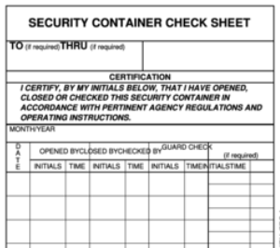
Management Internal Controls Program
DOCUMENTATION – Accessing Cash Funds In Safe
SF-702 Security Container Check Sheet
Ensure SF702 is posted outside of the container before opening safe
Fill out date and time container is opened (each time container is accessed)
Be sure to place your Initials in the second column
Safe must be secured (closed and locked) when not in use

Slide 8
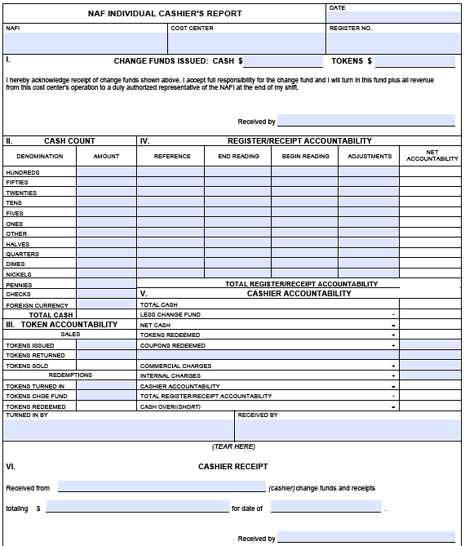
Management Internal Controls Program
RECORDS – 1875 Transactions and Events
At Start of Shift, verify amount of funds in the cash drawer using AF Form 1875
Once cash drawer is verified, cashier signs the 1875 indicating they have received the funds

Slide 9
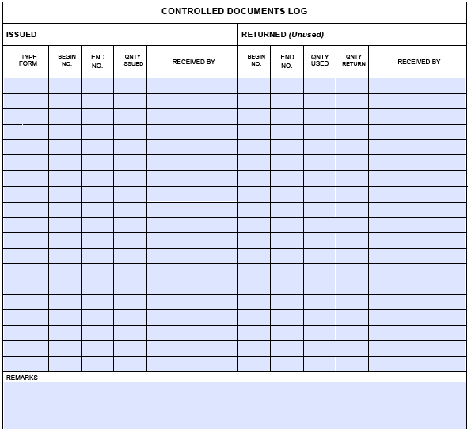
Management Internal Controls Program
RECORDS – 1875 Transactions and Events
At Start of Shift, Collect all controlled items from the safe / storeroom to operate for the business day
Immediately update form If more items are needed throughout the day
Annotate number of items taken on the back of the AF Form 1875 (controlled documents log
Once both sides of the 1875 is completed, place inside of safe and secure.
* Controlled items include FSS Gift Cards, IT&T tickets, etc.

Slide 10
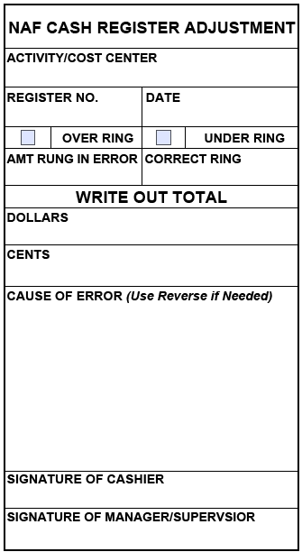
Management Internal Controls Program
AUTHORIZATION – TRANSACTION APPROVAL PROCESS
Register Adjustments
If a transaction is rung into the register/POS in error, complete an AF Form 645 for each occurrence
A manager or supervisor must countersign for each correction
* This transaction is annotated on AF Form 1875 under the “Adjustments” column

Slide 11
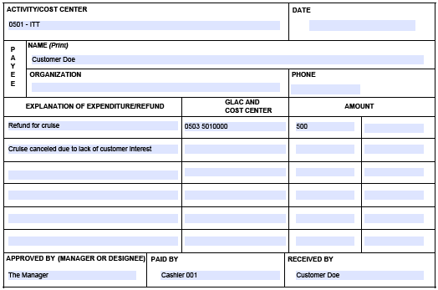
Management Internal Controls Program
STRUCTURE – SEPARATION OF DUTIES, PREVENTIVE INTERNAL CONTROLS
Petty Cash and Refunds
Utilize AF Form 1401 for petty cash expenses and/or refunds
A manager or supervisor must approve the expense before a disbursement is made
Be sure customer signs as received and obtain a phone number if possible
* This transaction is annotated on AF Form 1875 under the “Adjustments” column
Notes:
Safety Programs - Since people are our most important asset, many internal controls deal with personal safety. Such things as training requirements and safety procedures all serve to make the workplace a safe and healthy environment.

Slide 12
Management Internal Controls Program
STRUCTURE – SEPARATION OF DUTIES, PREVENTIVE INTERNAL CONTROLS
Cashier End of Shift Accountability
At the end of shift, cashier completes the “Cash Count” portion on the 1875
Supervisor and Cashier will verify cash drawer and then sign
Receiving supervisor completes bottom portion of the 1875, sign as receiver and provide a copy of the cashier receipt to cashier
Notes:
Separation of Duties
This type control involves the splitting up responsibilities so that no one person can fully control an activity or transaction
No one person should be able to:
Initiate transactions
Approve transactions
Record transactions
Reconcile balances
Handle or receive assets
Review Reports

Slide 13
Management Internal Controls Program
STRUCTURE – SEPARATION OF DUTIES, PREVENTIVE INTERNAL CONTROLS
Cashier End of Shift cont…
Annotate number of items returned on the back of the AF Form 1875 (controlled documents log)
Supervisor signs as received
Once the 1875 is completed, cash, credit card receipts, AF645/AF1401 (as applicable), and point of sale report should be attached to 1875 and placed in safe

Slide 14
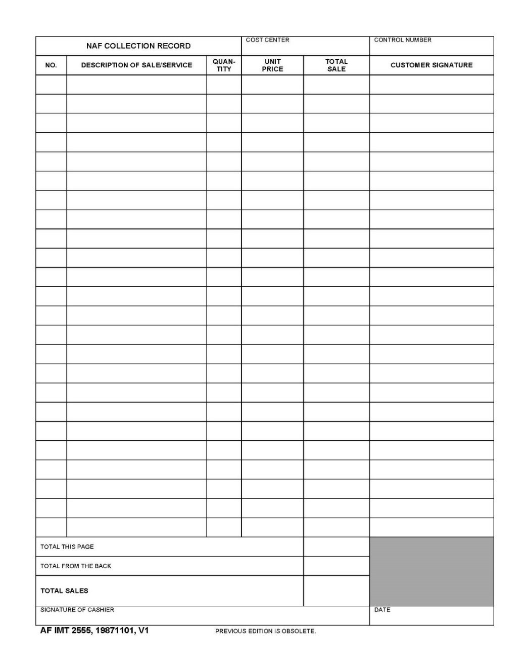
Management Internal Controls Program
STRUCTURE – SEPARATION OF DUTIES, PREVENTIVE INTERNAL CONTROLS
Cash Register Contingency
AF Form 2555 takes the place of register tape if no register is available at a facility
(Only authorized if sales are below $1,000
per month. Must use a cash box)
Requires RM approval
AF Form 2555 can be used in an emergency for example, existing pos system or cash register breaks.
Total Sales listed on form must balance to the cash / checks / credit cards

Slide 15
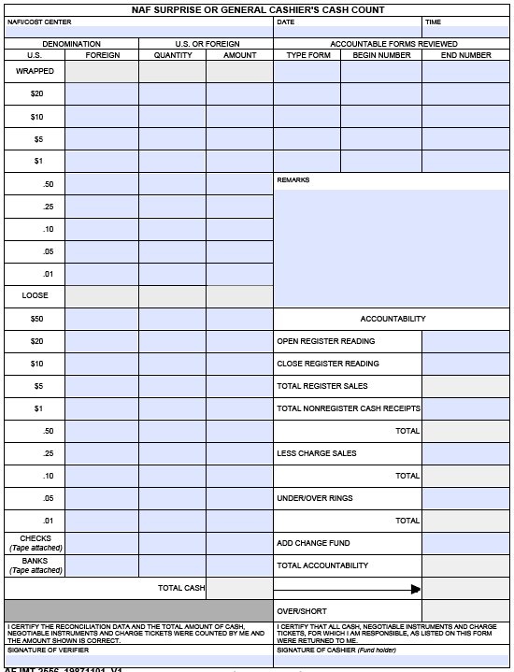
Management Internal Controls Program
SUPERVISION – (Super-Vision) Is DETECTIVE INTERNAL CONTROLS
Funds Accountability
At the end of each day, funds in the safe will be counted using AF Form 2556
If keeping the cash deposit separate from the change fund, annotate the amount of funds in the “Remarks” section
Once verified, the safe may be secured and the SF702 filled out (“Closed by”)
Notes:
Security controls include:
Physical Inventories: Inspecting assets on hand and matching them to what’s in the books helps to detect missing items.
Anti-theft: Locks, alarms, cameras, and security personnel prevent and detect theft of important assets.

Slide 16
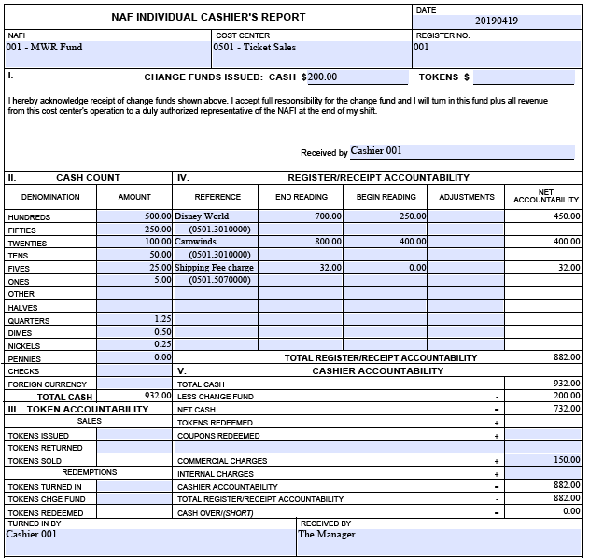
Management Internal Controls Program
SUPERVISION – (Super-Vision) Is DETECTIVE INTERNAL CONTROLS
Deposit Preparation
The supervisor will take the POS report and transfer the accountability data to the form
Once accountability has been calculated, the cash deposit and credit card settlement can be added
Calculate the over/short at this time
Notes:
Supervision (super-vision):
This internal control is performed by people and is probably the most common.
Supervision includes instructing others, overseeing work as it is done, reviewing work already done, approving actions, etc.

Slide 17
Management Internal Controls Program
SUPERVISION – (Super-Vision) Is DETECTIVE INTERNAL CONTROLS
Deposit Preparation cont…
If a cash overage or shortage of $10.00 or more exists between the cash and POS report, contact your Resource Manager, in writing, immediately
At no time should this be calculated in front of cashier, nor should a manual “correction” be made to the cash deposit
Employees can not use their personal funds to correct shortages nor take cash from overages
Notes:
Internal Controls also includes operational and financial classifications:
Operational – Promotes operational effectiveness and efficiency as well as adherence to policies and procedures.
Financial – Safeguards assets and ensures completeness, accuracy and reliability of financial records.

Slide 18
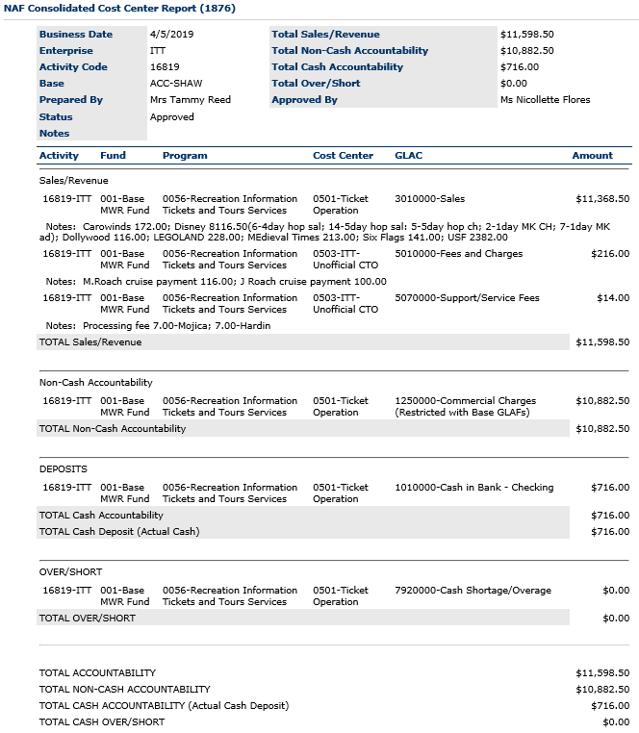
Management Internal Controls Program
SUPERVISION – (Super-Vision) Is DETECTIVE INTERNAL CONTROLS
Deposit Preparation cont…
Post your daily revenue using AF Form 1876 (through the SAIS / NAFDIS program)
Pay close attention to the lines of accounting utilized for each transaction
(see slide “Lines of Accounting”)

Slide 19
Management Internal Controls Program
SUPERVISION – (Super-Vision) Is DETECTIVE INTERNAL CONTROLS
Deposit Preparation cont…
An AF Form 1876 should be completed and approved
every business day
If shut down on a typical business day for any reason (i.e. snow day) an AF 1876 should still be accomplished with the header notes referencing the reason for the lack of business

Slide 20
Management Internal Controls Program
Internal Controls are necessary to ensure MWR assets are protected, and liabilities are kept to a minimum
Secure the safe and room (if applicable) once all funds and controlled items have been obtained / stored
If additional items (gift cards, tickets, etc.) are required throughout the day, be sure to annotate the applicable cashier’s AF1875
Access to the cash drawer and safe should be closely monitored at all times and only be accessible by authorized personnel
Keys and safe combinations should be kept in a secure area and/or retained by an authorized individual
Notes:
NOTE: A surprise cash count can happen at any time. Missing any of these steps may result in a variance which would require further documentation and/or investigation.

Slide 21
Commonly used Lines of Accounting
GLAC | Title | Description
Revenue Accounts
3010000 | Sales | Sale of resale inventory
3010001 | Sales, Non-tip Environment | Sale of resale inventory in a non-tipping section of the facility (used when an activity includes both tipped and non-tipped environments
3010002 | Cash Sales, Tip Environment | CASH sales of resale inventory in a tipping environment (do not add the amount tipped into the sales total)
3010004 | Charge Sales, Tip Environment w/ tips | CREDIT CARD sales of resale inventory in a tipping environment (do not add the amount tipped into the sales total)
3040000 | Sales Discounts, Members First | Discounts given against sales (report whole sales [301xxxx] amount as cash accountability, then report discounts given separately as non-cash accountability on the AF1876)
5010000 | Fees and Charges | Fees charged for services provided

Slide 22
Commonly used Lines of Accounting
GLAC | Title | Description
Holding Accounts
1150000 | Outside Agency Receivable | (Cash accountability) Payment received for services or goods previously provided and setup as a receivable. Payment is recorded as cash / credit (depending upon method) on the non-cash accountability portion of the AF1876 as the offset. (Non-cash accountability) Services or goods provided, but have yet to receive payment from the responsible party. Sales are reported in the cash accountability portion as the offset.
1180001 | Customer Accounts Receivable | (Lodging specific) See above.
2140000 | Charge Tips / Paid out tips | (Cash accountability) Tips received from customers via credit card… owed to employees. (Non-cash accountability) Tips taken from cash revenue and then paid to employees. Document this transaction with either an AF1401 or AF2557.
2320000 | Unearned Income – Defined Period | Funds received, but not yet earned. The month in which the revenue will be earned is known
2330000 | Unearned Income – Undefined Period | Funds received, but not yet earned. The month in which the revenue will be earned is unknown

Slide 23
86FSS Internal Controls Management Oversight
FSS Commander/Director
NAFFA
Resource Manager
Flight Chief
Activity Manager

Slide 24
The F$$ Commander has management responsibility for all flights in the squadron
Nonappropriated Funds Financial Analyst (NAFFA) in the Base Comptrollers office performs an “External” on site oversight function. The NAFFA is responsible for conducting certain annual reviews. The NAFFA documents findings and makes recommendations, as well as provides feedback to management, the NAF Council, installation commander, FSS Commander/Director and the RM
The Resource Manager
(RM) is the installation NAFI Custodian and is responsible for receiving, disbursing and safeguarding funds, and other NAF assets. The RM maintains overall responsibility that resources are effectively managed. The RM must ensure personnel handling cash are properly trained. The RM is responsible for ensuring managers implement internal control procedures and self-inspect their activities.
The Flight Chief has overall management responsibility for all activities in a particular flight. Activity Managers control daily operations and resources such as labor, inventory, cost of goods, and property. Managers use a system of daily observations, daily reports, self-inspections, inventories, local reviews, cash counts, audits, etc., to help them monitor the activities operational effectiveness

Slide 25
86 FSS Management Internal Controls Workshop Summary
Internal Controls is a plan of organization and all of the methods and measures adopted to safeguard resources, assure accuracy, and reliability of information, adherence to applicable laws, regulations, and policies, and promote operational economy and efficiencies.
Internal Control systems is only as effective as the people who operate it. Managers must ensure their activity is staffed with competent personnel who are motivated and understand what they have to do, appreciate why they have to do it, and agree that it must be done.
Proper stewardship of NAF resources is a fundamental responsibility of all of us. Implementation of Internal Controls are crucial to the separation of duties, supervision, computer system access, periodic review, and quality assurance evaluation reviews a contributing factor for our commander in assuring the community that our management controls are effective.

Slide 26
86 FORCE SUPPORT SQUADRON RESOURCE PROTECTION OFFICE
Questions?
POC for this presentation:
Ms. Sandra D. Johnson – 314-480-6035 (sandra.johnson.5@us.af.mil)
Ms. Elizabeth McCormick – 314-480-2453 (elizabeth.mccormick@us.af.mil)
Mr. Scott M. Wooley – 314-480-5979 (scott.wooley.1@us.af.mil)

